Slide 1
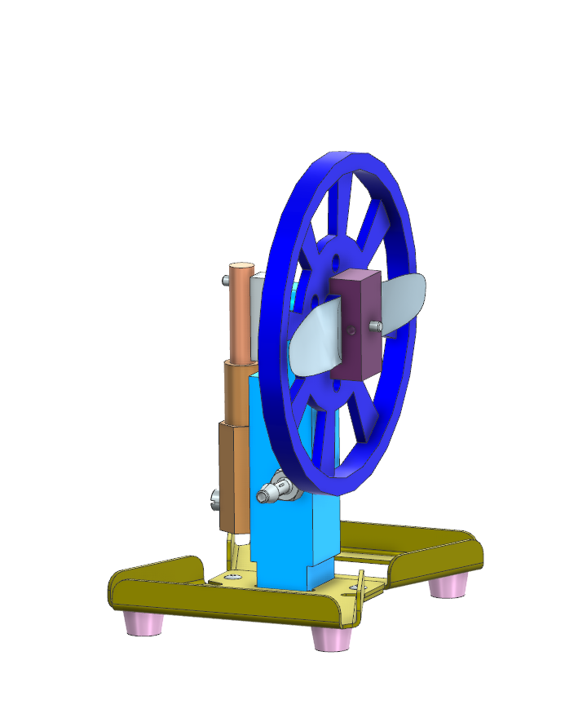

Jason Cao
Nov 17, 2025
Project 1 – Air Engine
CAD and Completed Assembly
I put in Mr. Alkins’ office
waited to take photo tomorrow

Slide 2
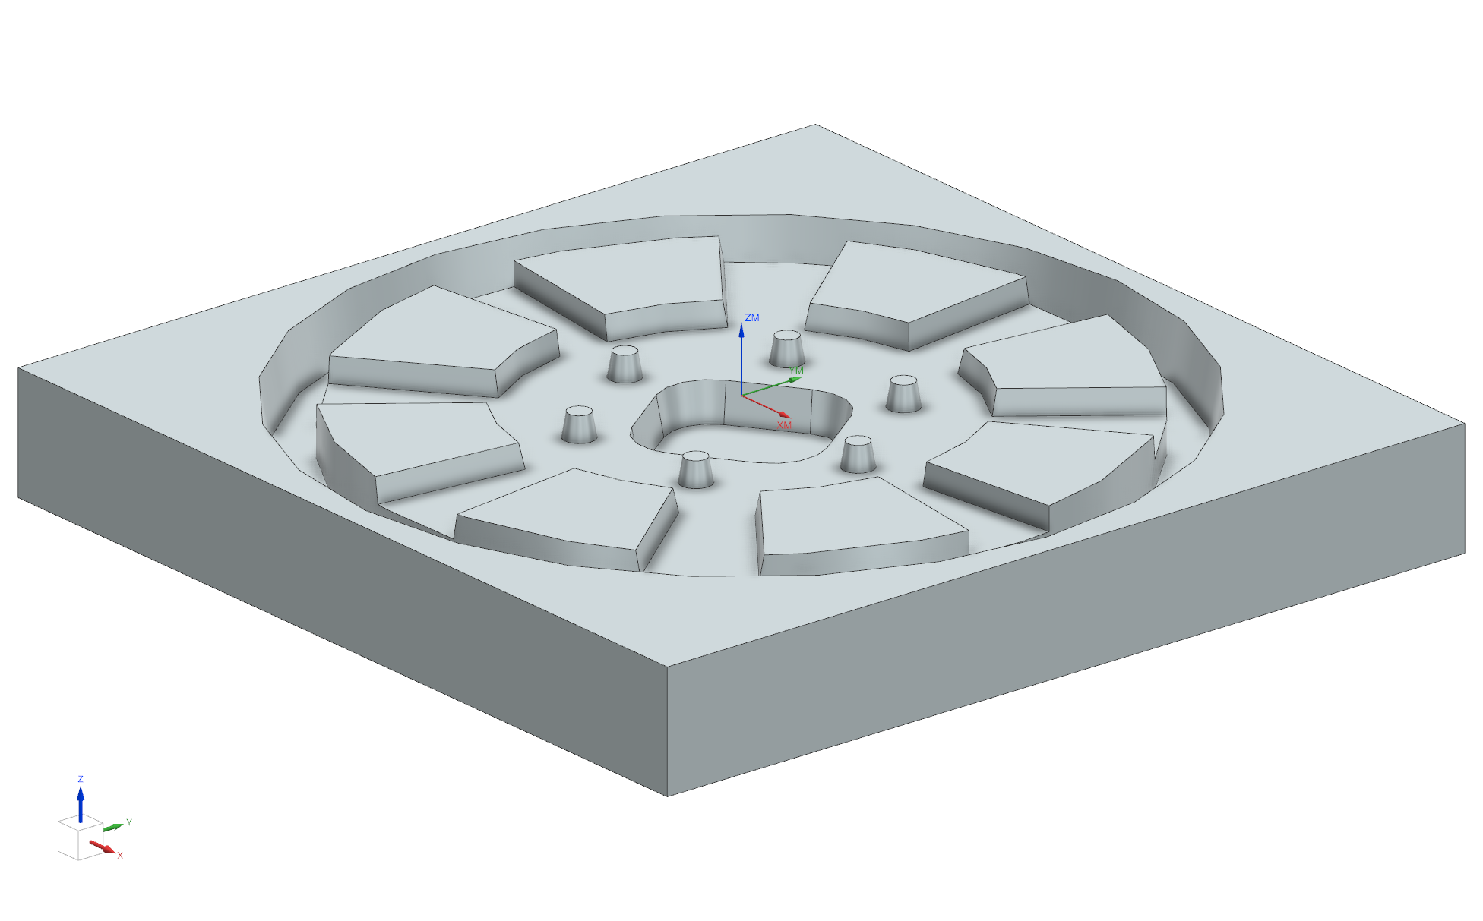
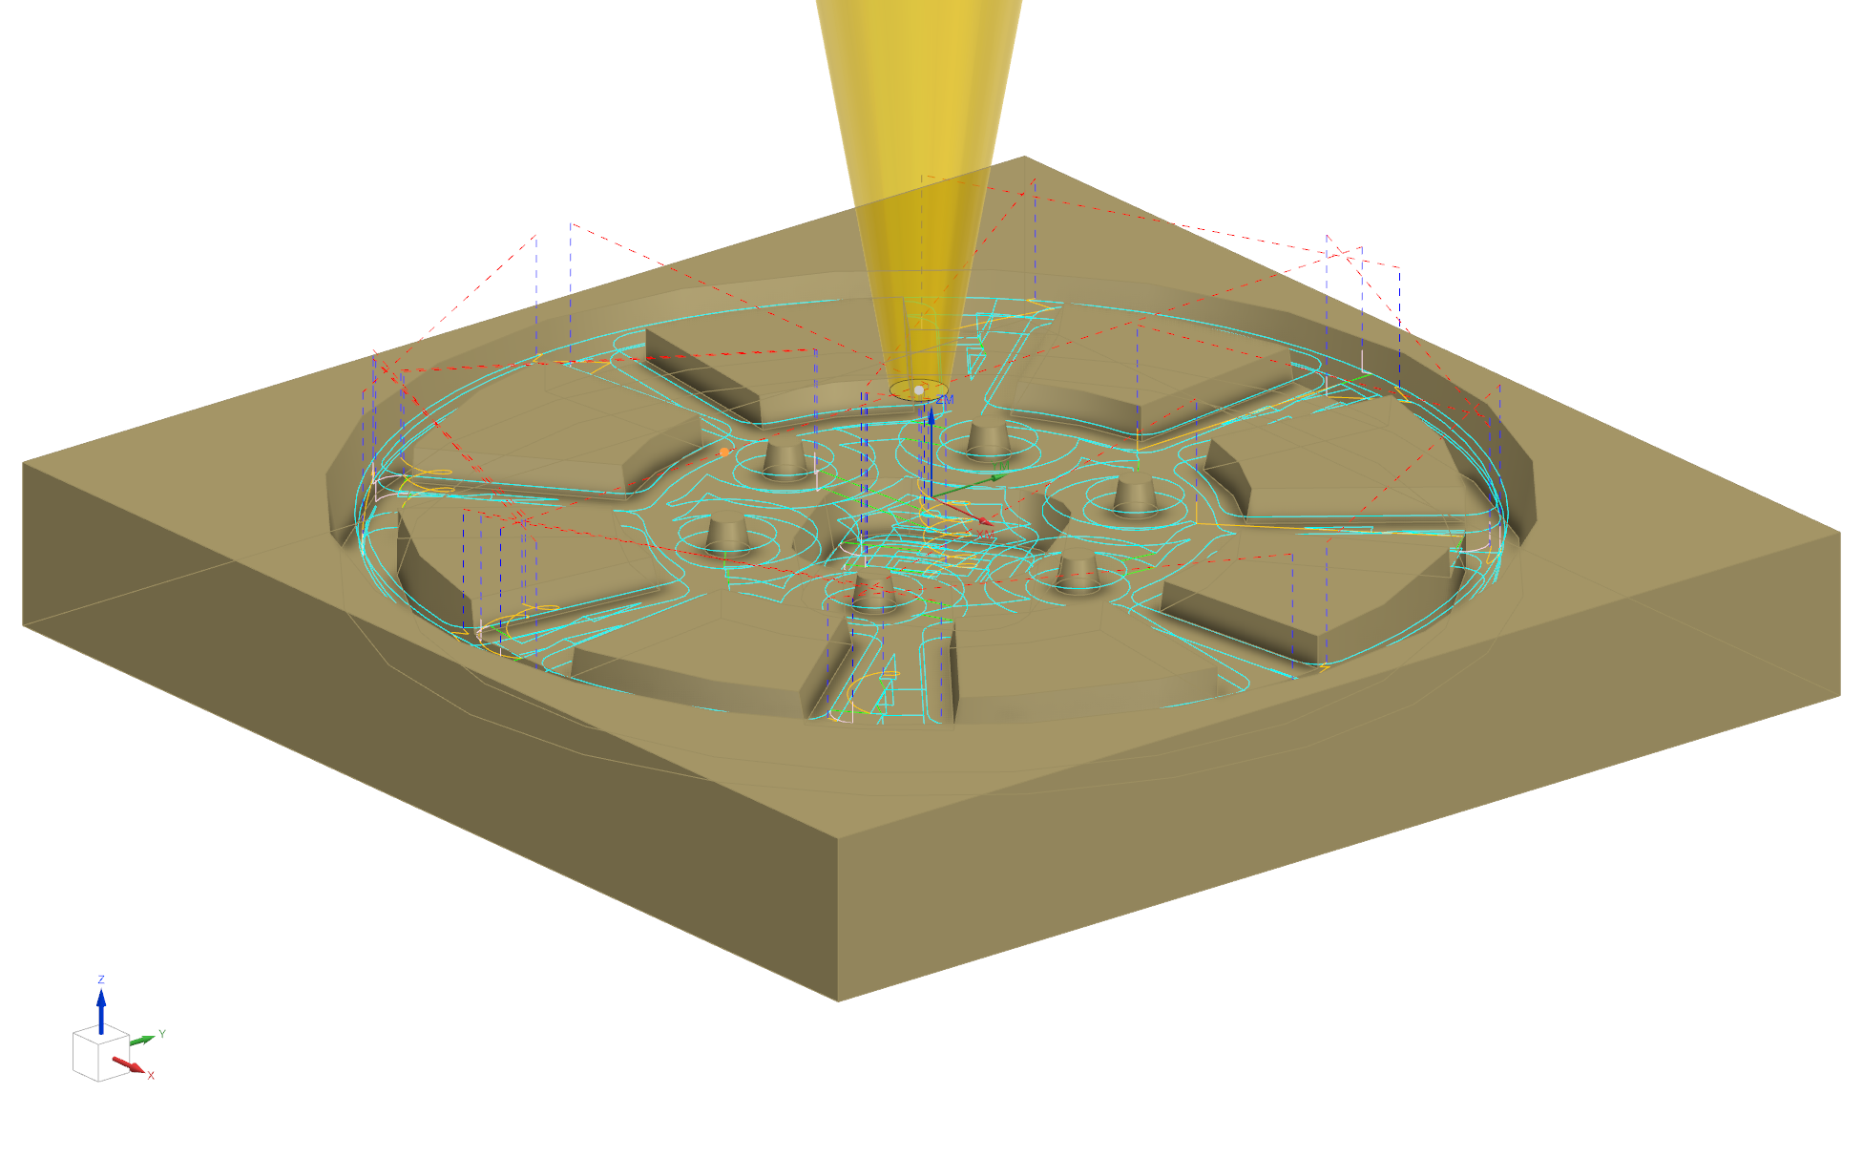
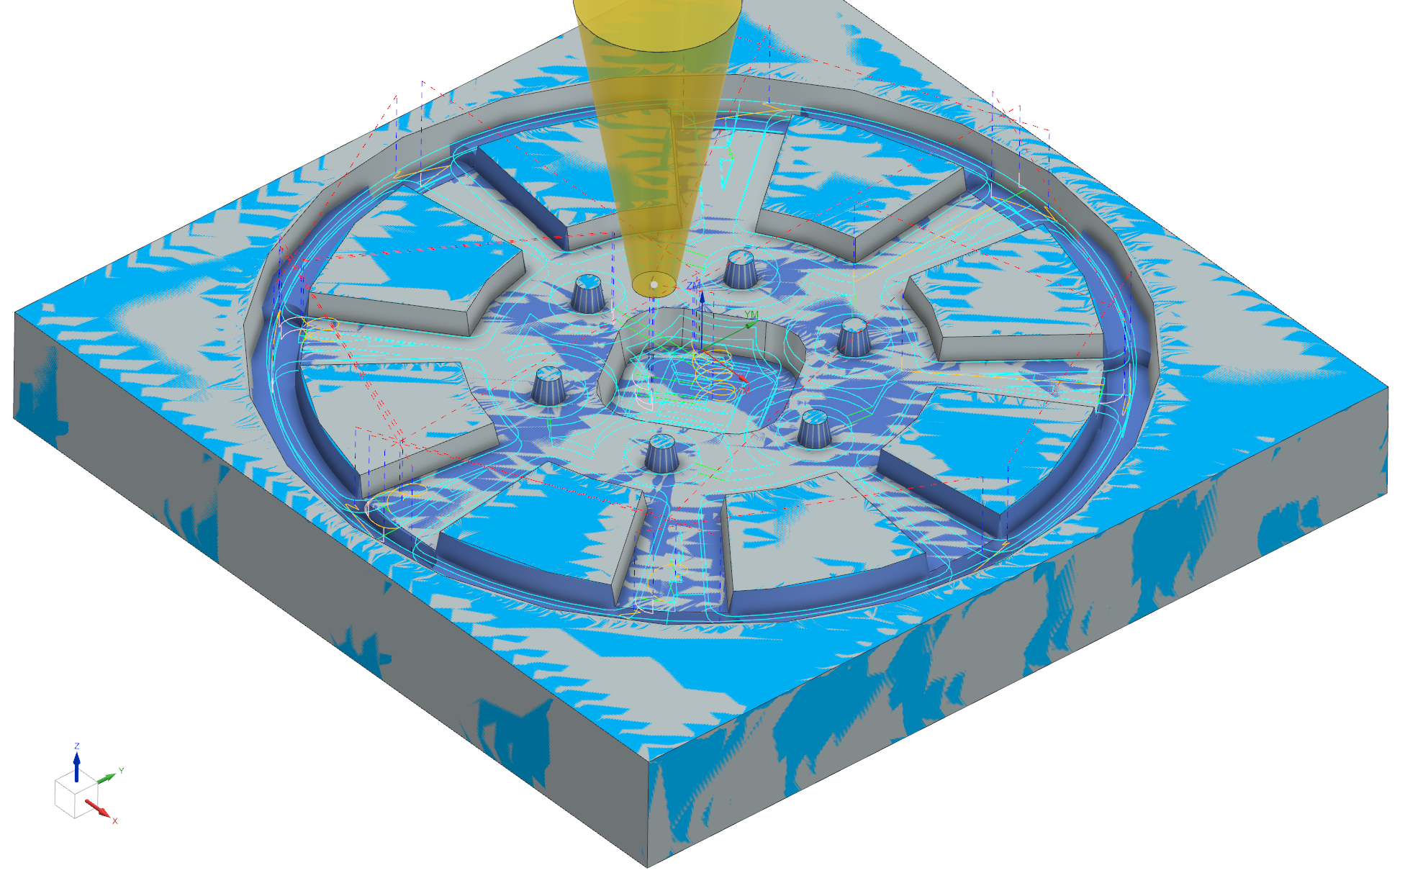
Date:11/17/25
Name: Jason Cao
Tool: 0.25x10Deg Taper
Stock: 5.5x 5.5 x0.75 Oak
Description: Mold Cavity
Part Reference: 26c016014A
Jason Cao
Project 1 – Air Engine
Process Sheet for mold making
MCS centered on top
Output from:
Program Data
Program Run: 09/18/2025 10:45:55
Linear Move Envelope:
X: -2.425 2.455
Y: -2.442 2.455
Z: -0.390 0.500
Maximum Feedrate: 50.000
Maximum Spindle: 16000.000
Minimum Z at Rapid: -0.250
The design is made based on how to generate
the largest inertia. Therefore, I left as much
volume as I can. This design is also inspired from
actual car wheels.

Slide 3
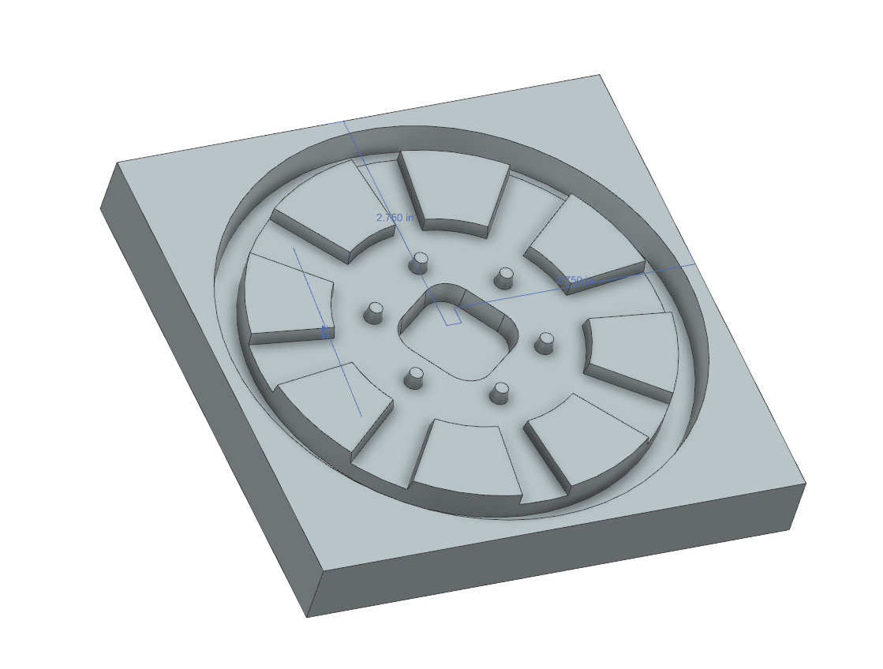
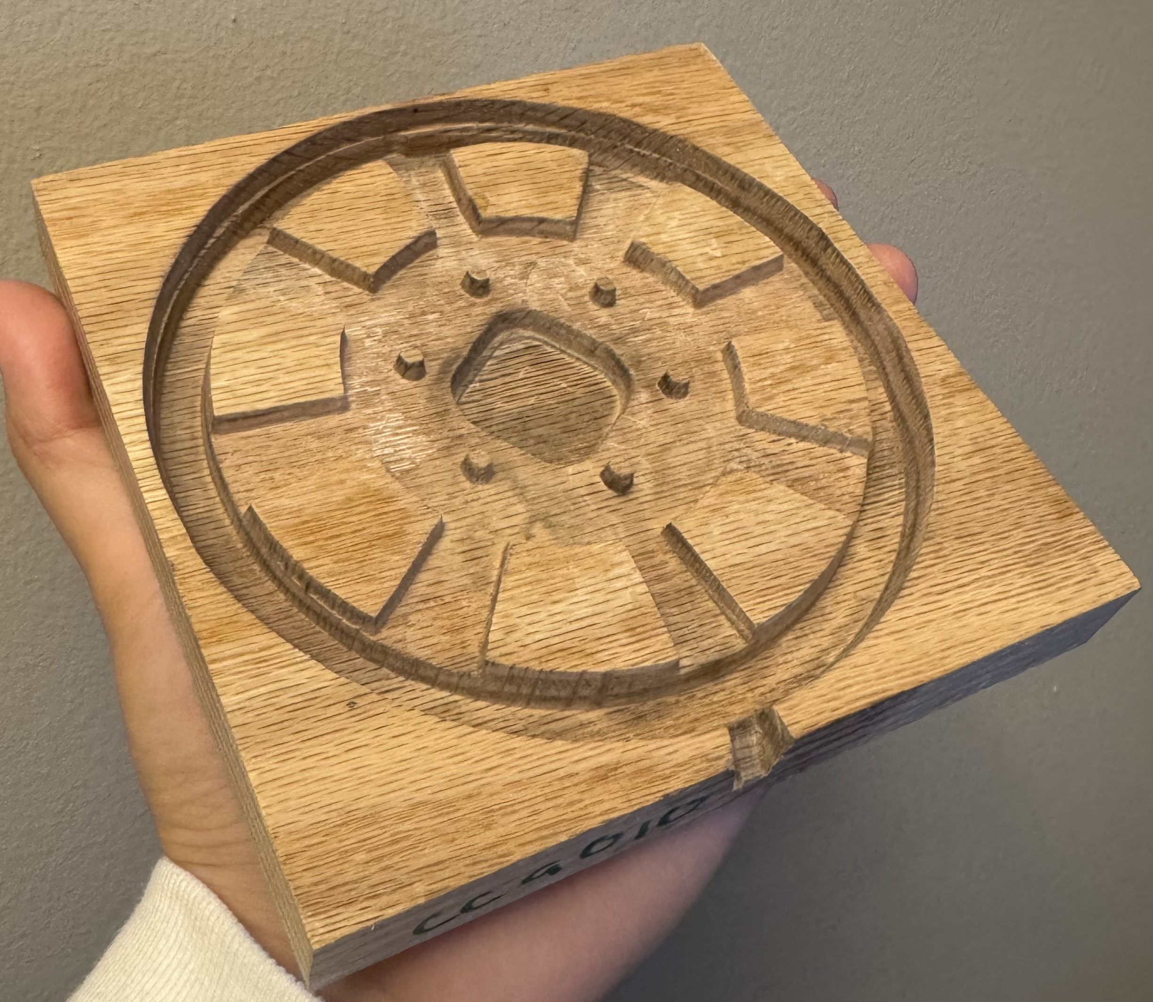
Jason Cao
Nov 17, 2025
Project 1 – Air Engine
CAD and Completed Assembly

Slide 4
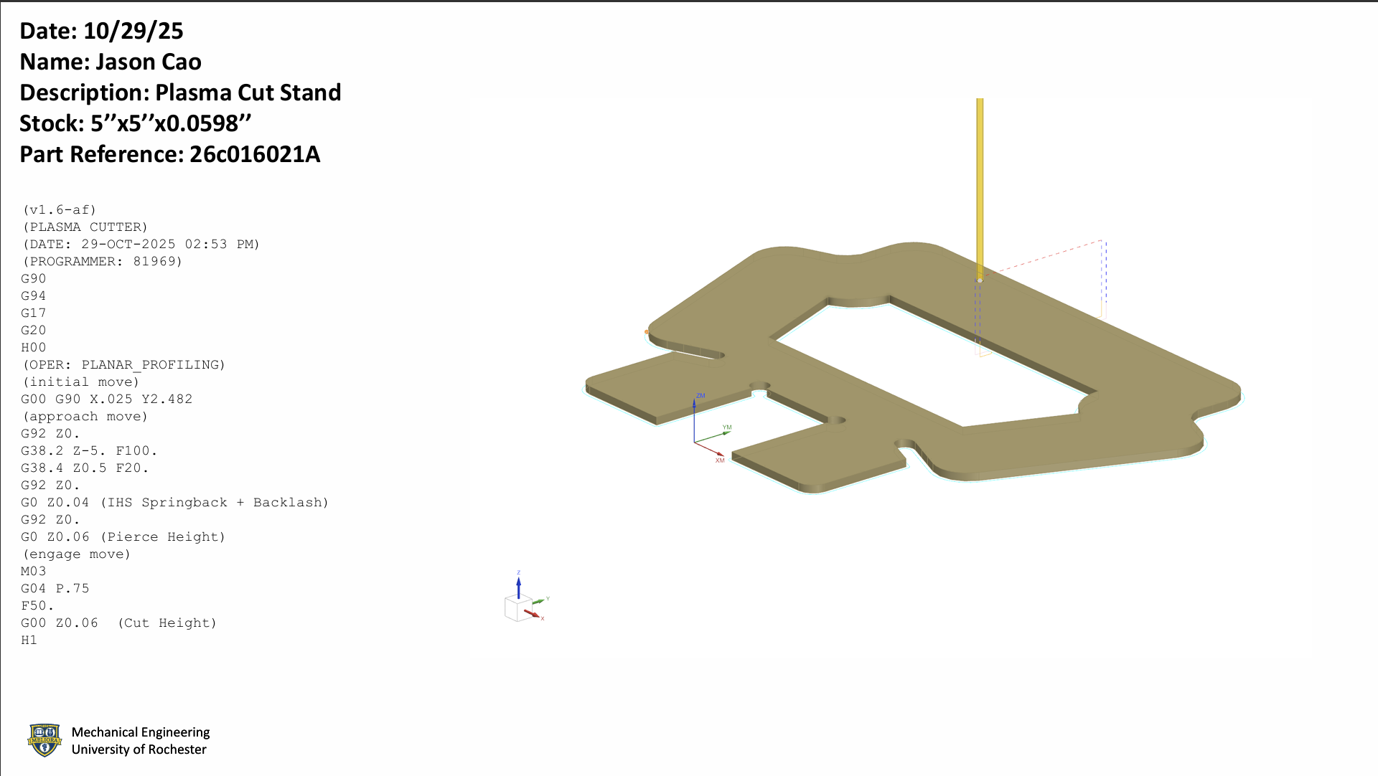
Jason Cao
Project 1 – Air Engine
Process Sheet for plasma cutting
Note: cut on Oct 30
The cut piece has rough edges on the top and bottom surface.
In order to fit the base with the backbone, I sanded the top surface making the edge is aligned with the smooth surface inside the edges.

Slide 5
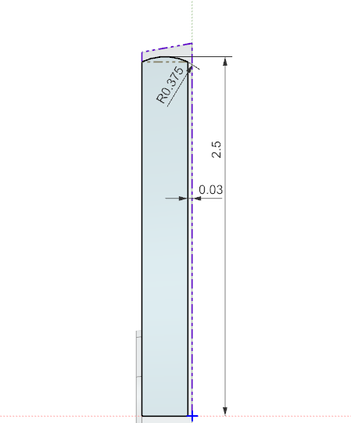
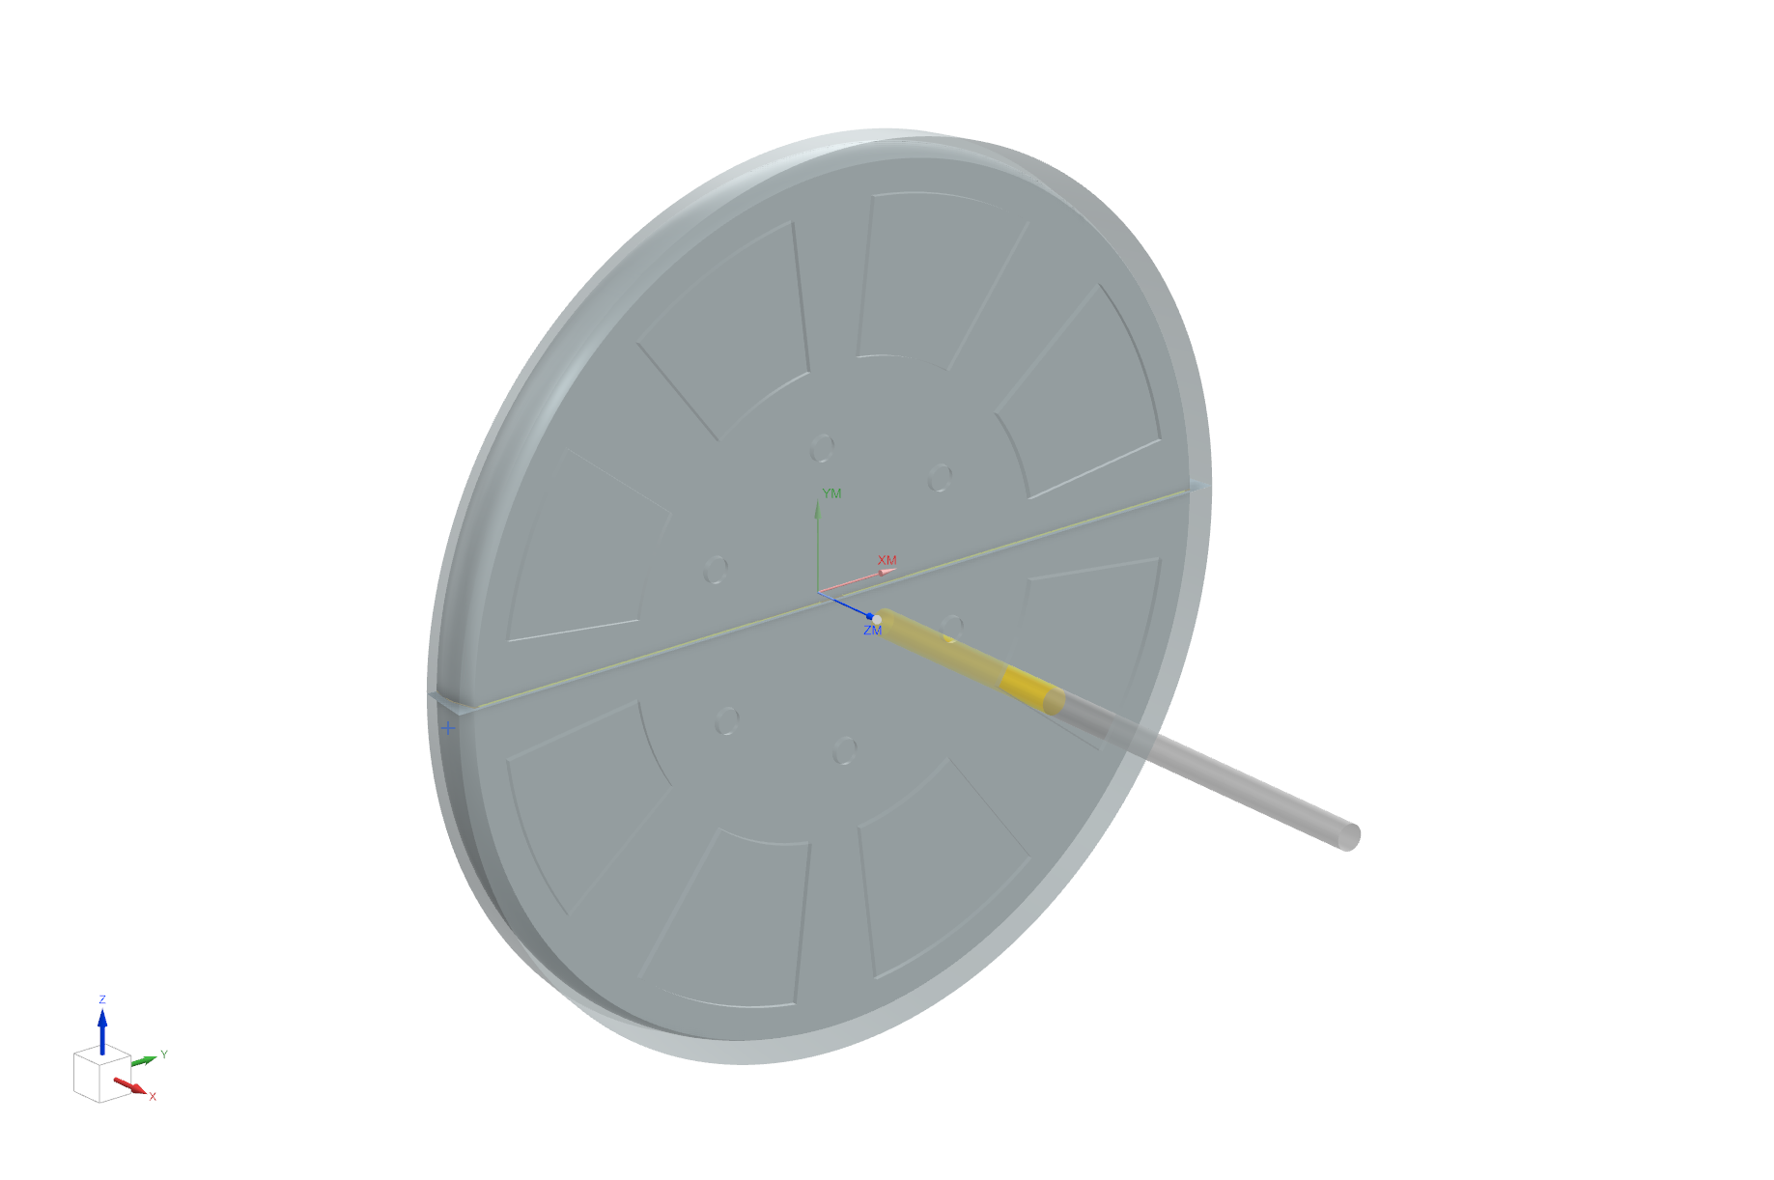
Date: 10/29/25
Name: Jason Cao
Description: Finish Flywheel
Stock: Cast Flywheel
Part Reference: 26c016022A
Jason Cao
Project 1 – Air Engine
Process Sheet CNC Turining
Note: cut on Oct 30
%
O0810 (PROGRAM)
( Date : Wed Oct 29 16:02:39 2025 )
( Programmer : 81969 )
( Part File Name: C:\Users\81969\OneDrive\Desktop\ME204\P1\cnc\26c016022A_setup_1.prt )
( Path Name : FACE_TURN )
(Tool Number: 2)
(Tool Name : CCGT431-HAL)
T0202
G97 S212 M3
G0 G54 X5.5 Z.25
The outside edge has an irregular indent. This is because when cast the flywheel with the mold, some places would cool faster causing the air bubble inside the mold. These air bubble would cause the incomplete formation which is the irregular indent.

Slide 6
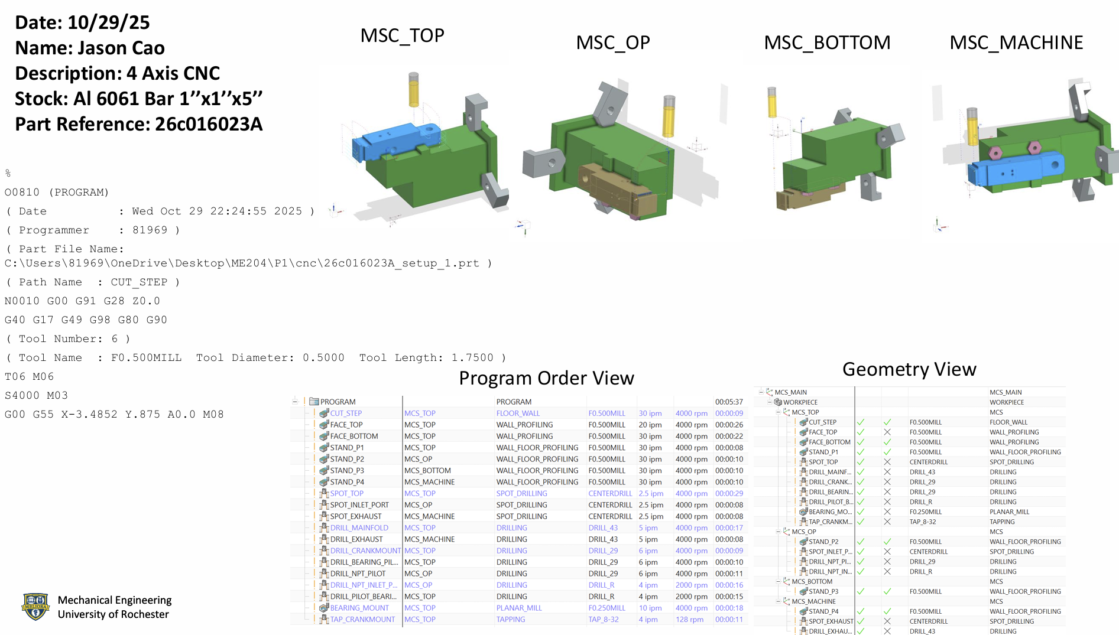
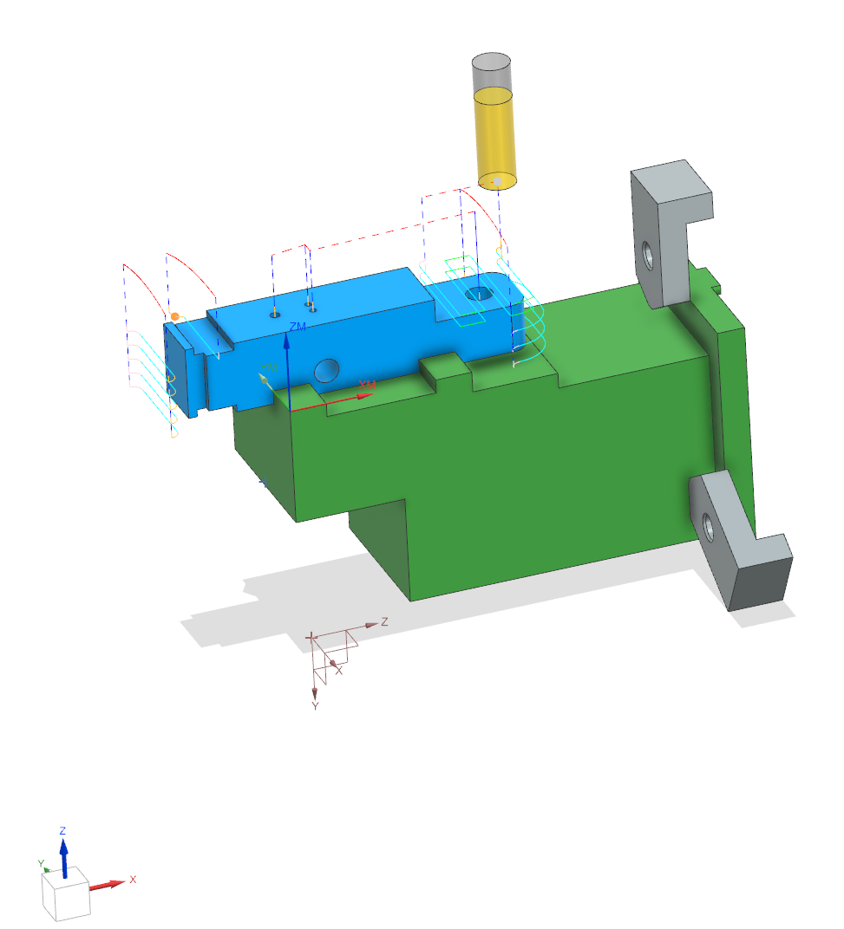
Note: cut on Oct 30
The CNC milling is very precise. I didn’t change any thing
after the process.
Jason Cao
Nov 17, 2025
Project 1 – Air Engine
Process sheet CNC Milling

Slide 7
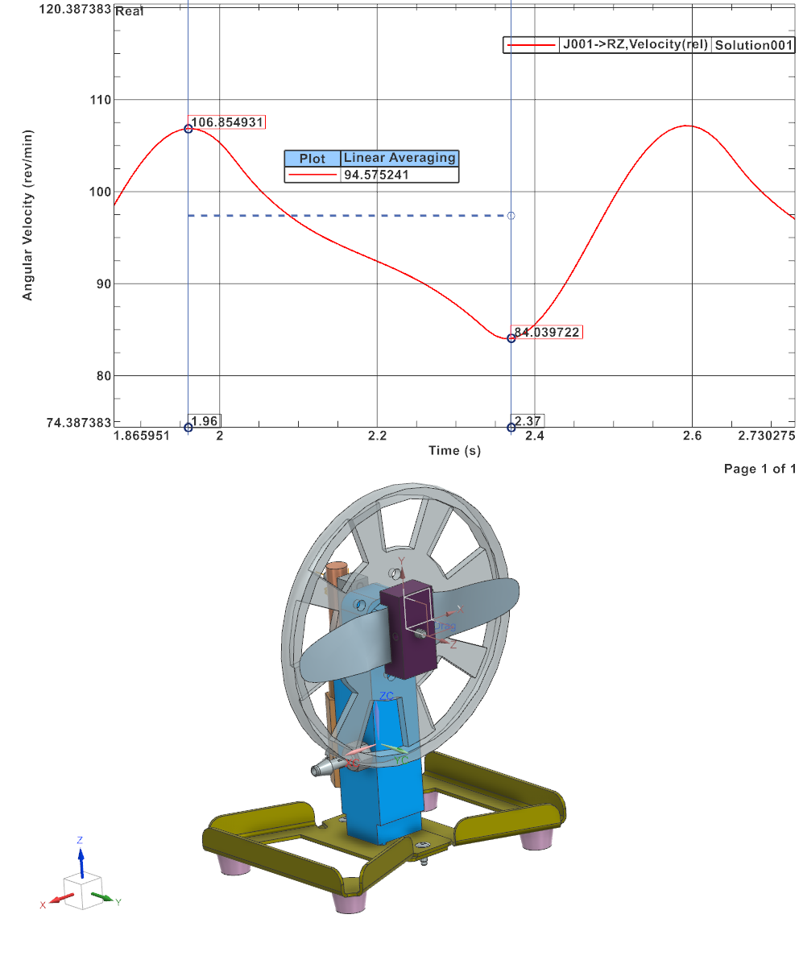
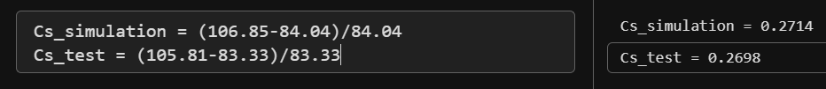
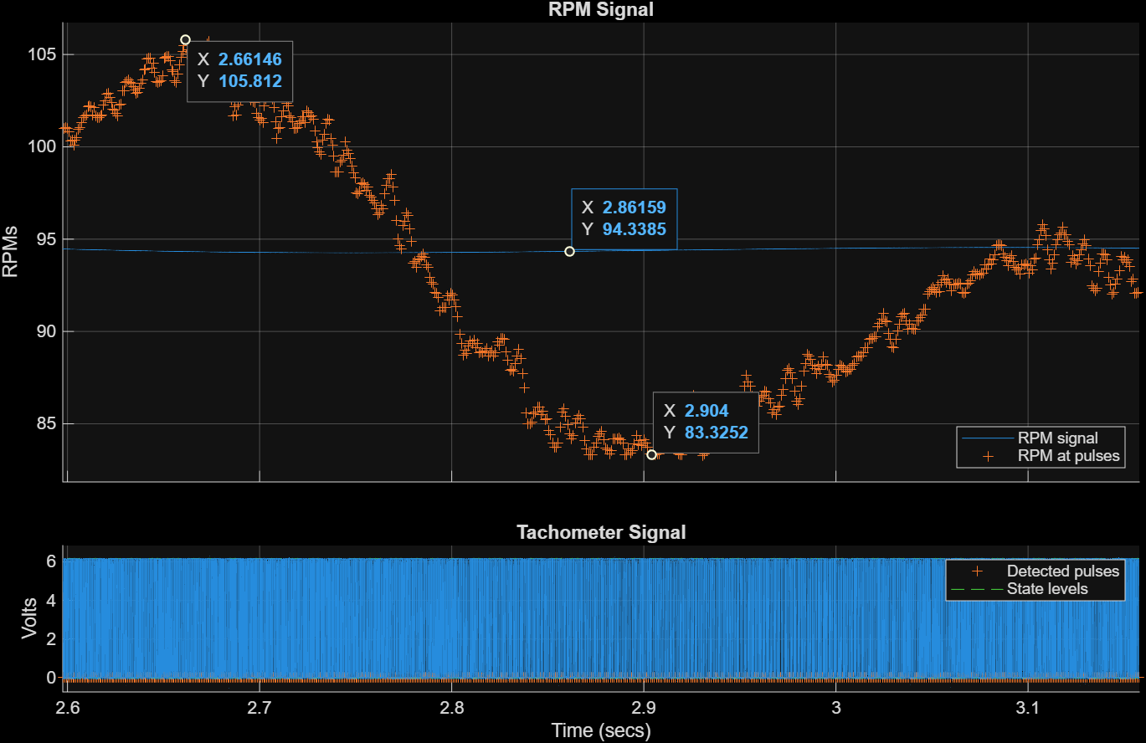
Jason Cao
Nov 17, 2025
Project 1 – Air Engine
Mechanism Simulation and Test
The differences in Cs is because of the drag force applied in simulation is not the real friction in the testing. The simulation only has drag force at the pin, but in the real testing, the friction also contains the hexagonal surface contacting with the backbone surface.
Cs difference with in 10%
average pressure 3.32psi [1.60psi 5.24psi]

Slide 8
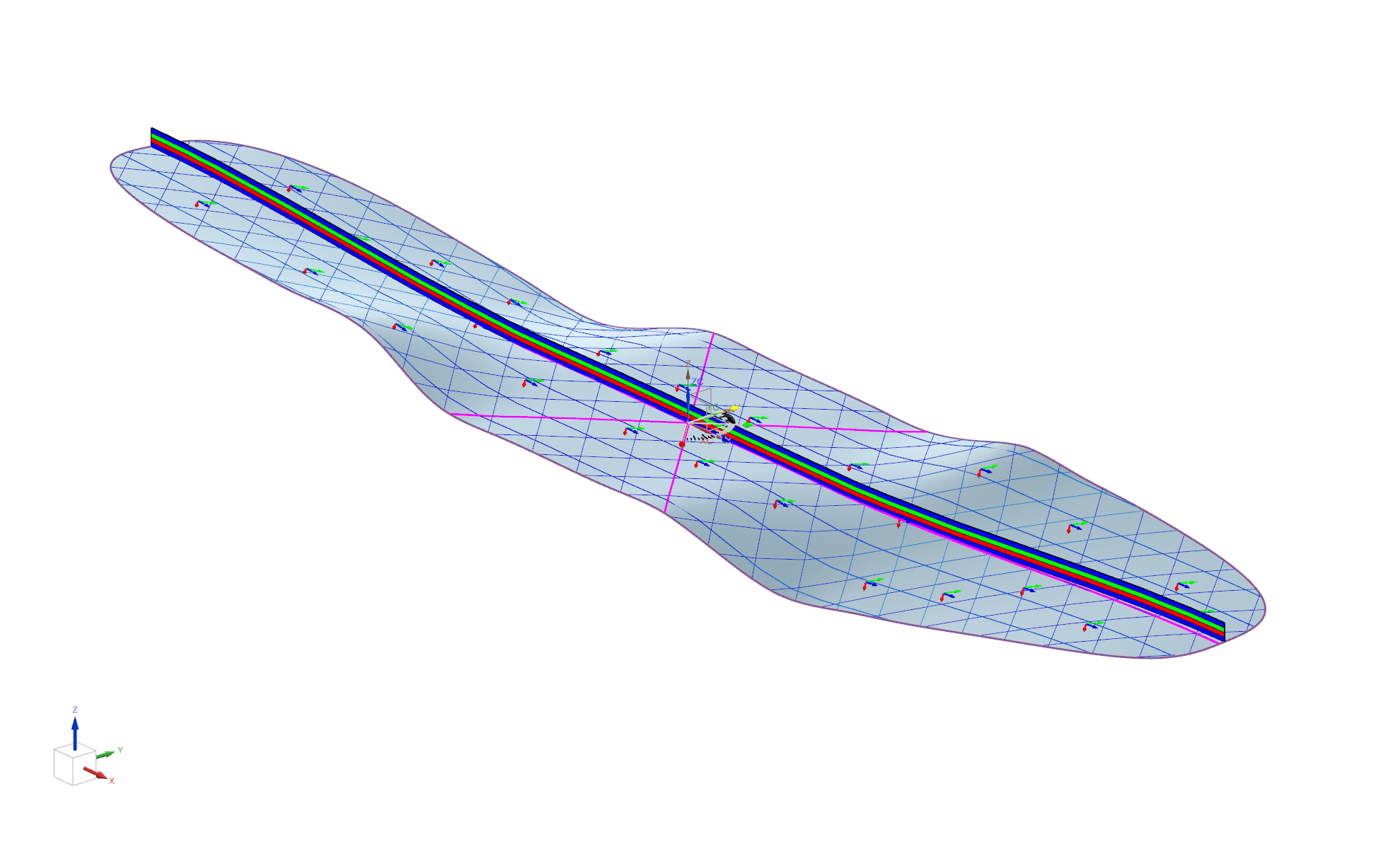
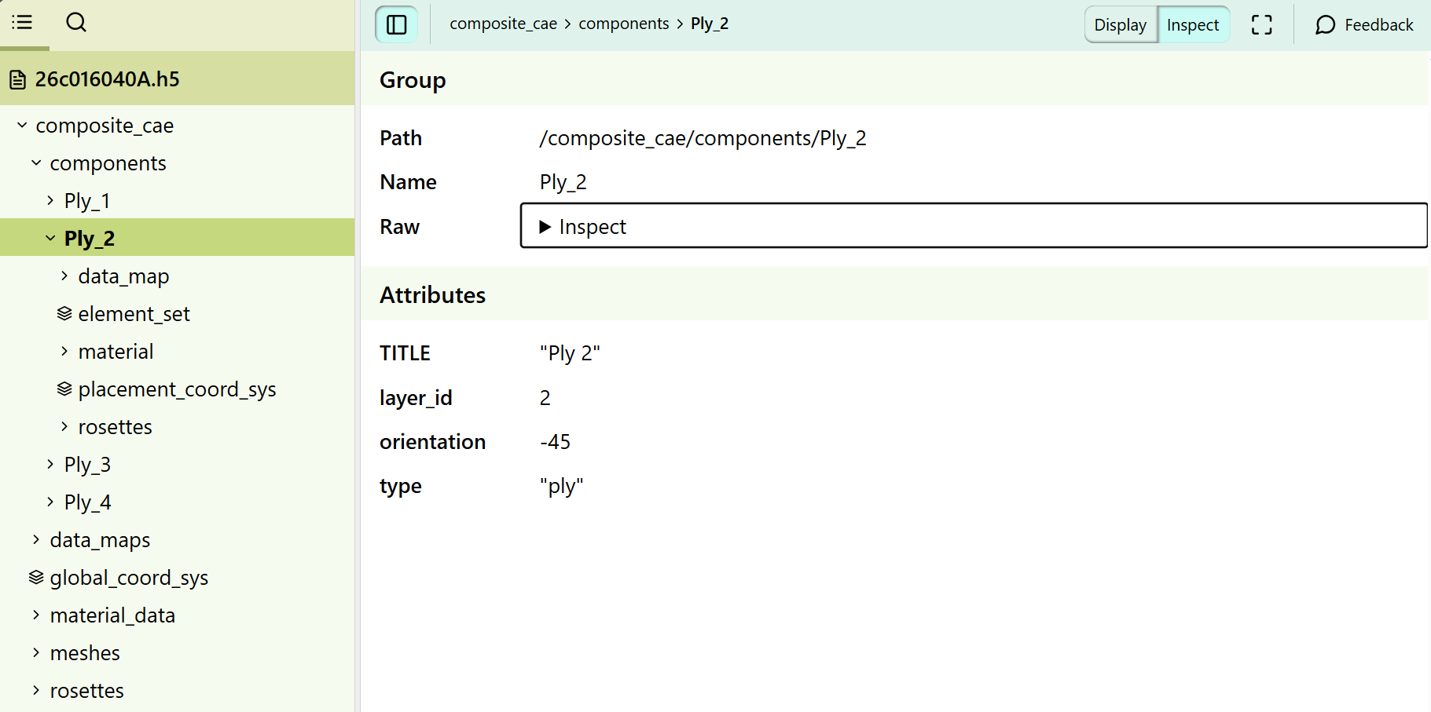
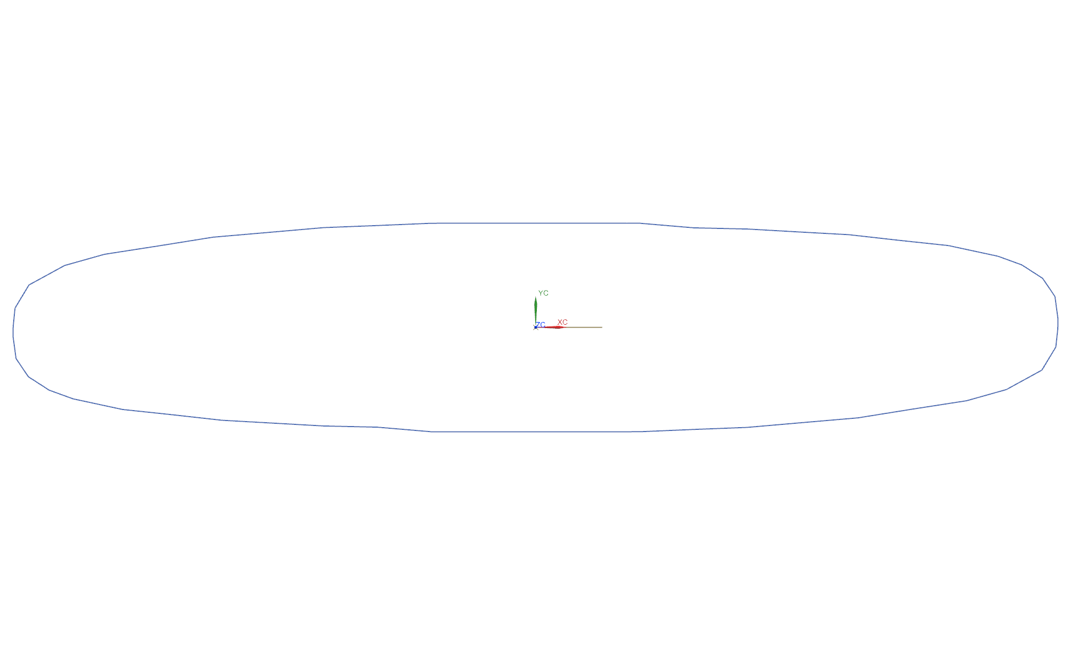
Jason Cao
Nov 17, 2025
Project 1 – Air Engine
Composite Information
First, we put the 0 degree composite layer on the metal mold. Then, stack the 45 degree layer on the top of 0 degree. And put the -45 on the top of previous one. Finally, put another 0 degree layer on the top of -45 degree one. The directions would make the strength of the fiber layup higher because the 45 degrees can increase the resistance to shear forces and twisting forces. And the 0 degrees can carry the maximum tensile forces. By the superposition of the ply, it makes the strength of fiber layup higher.

Slide 9
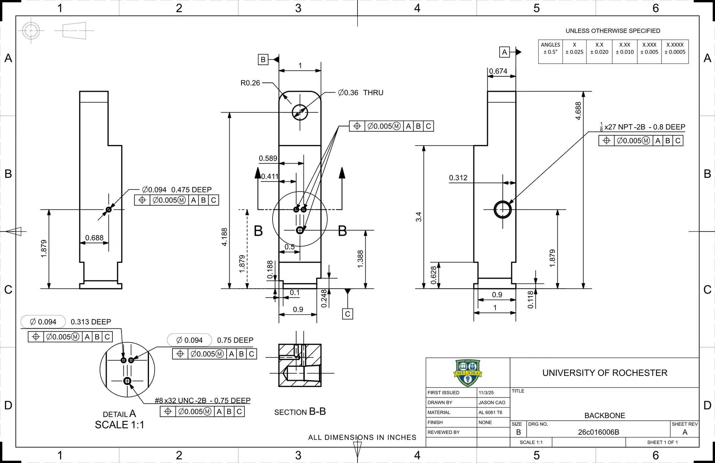
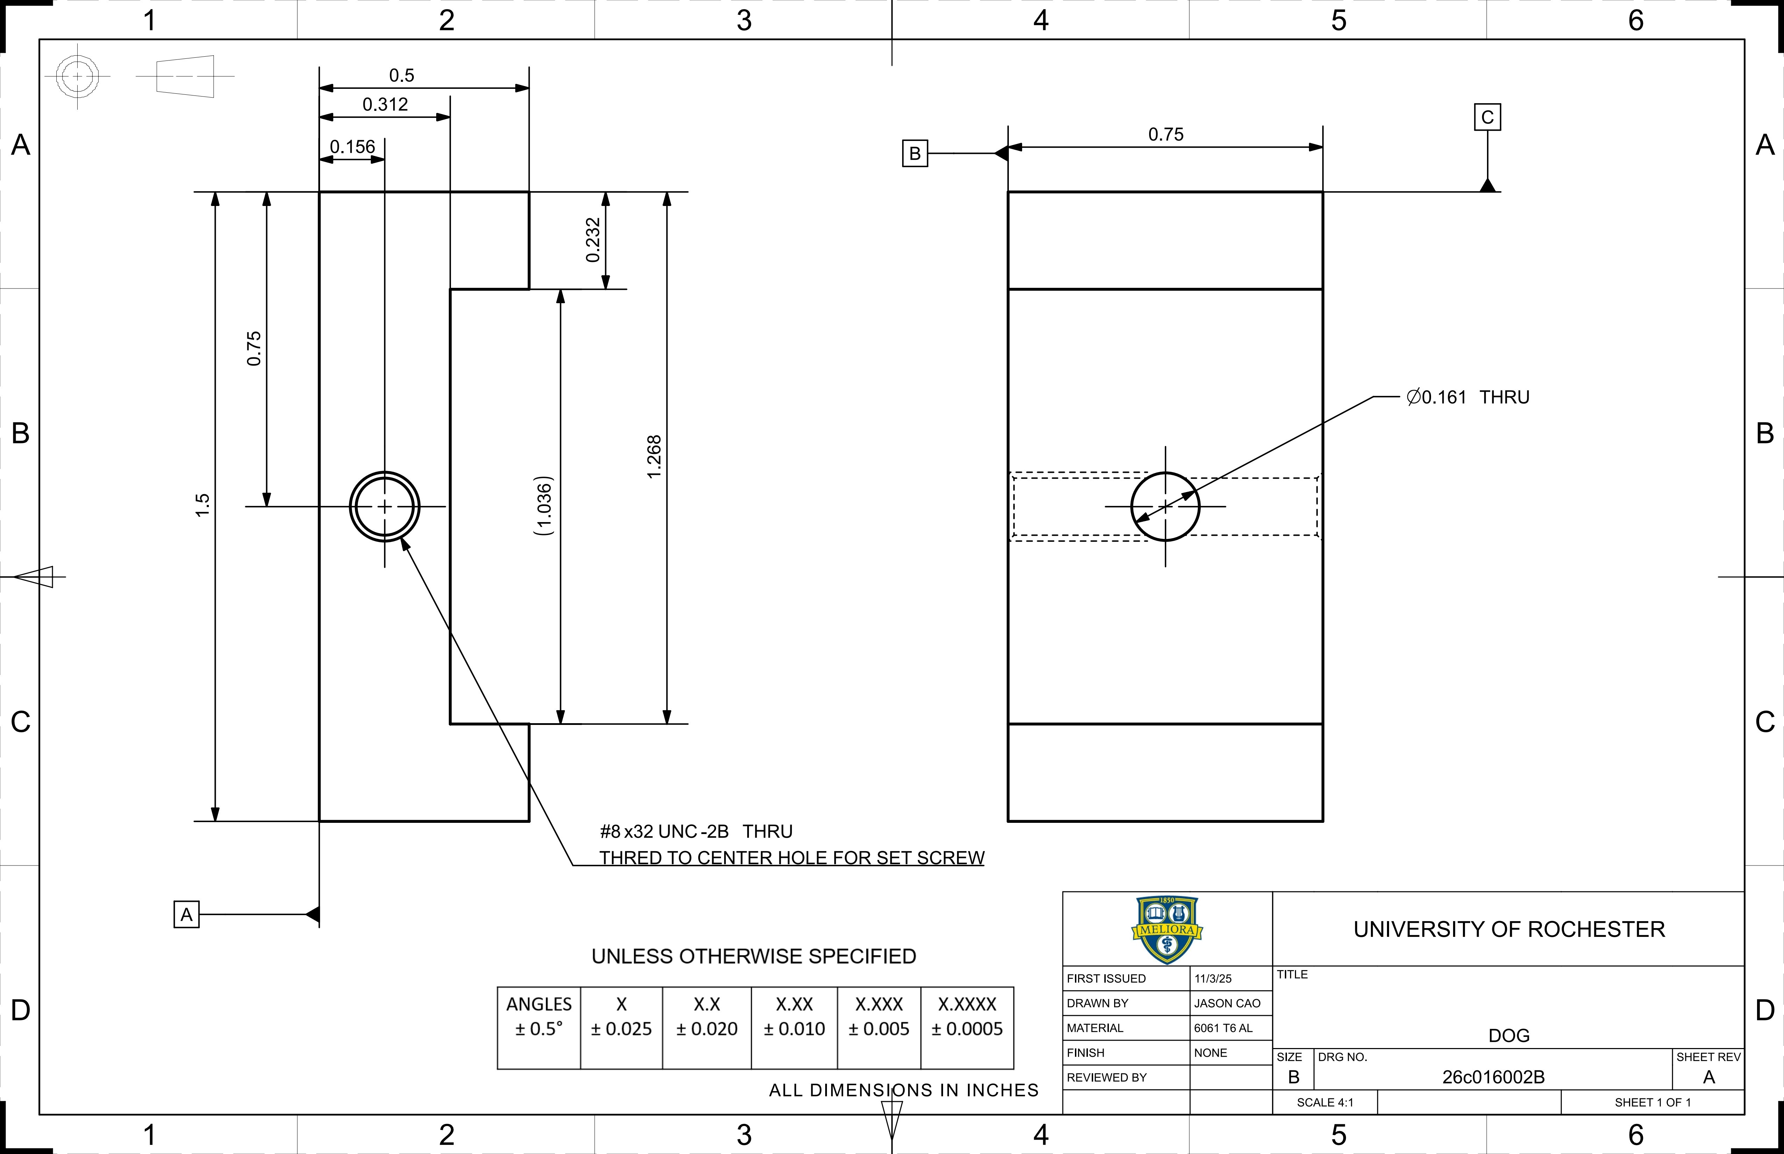
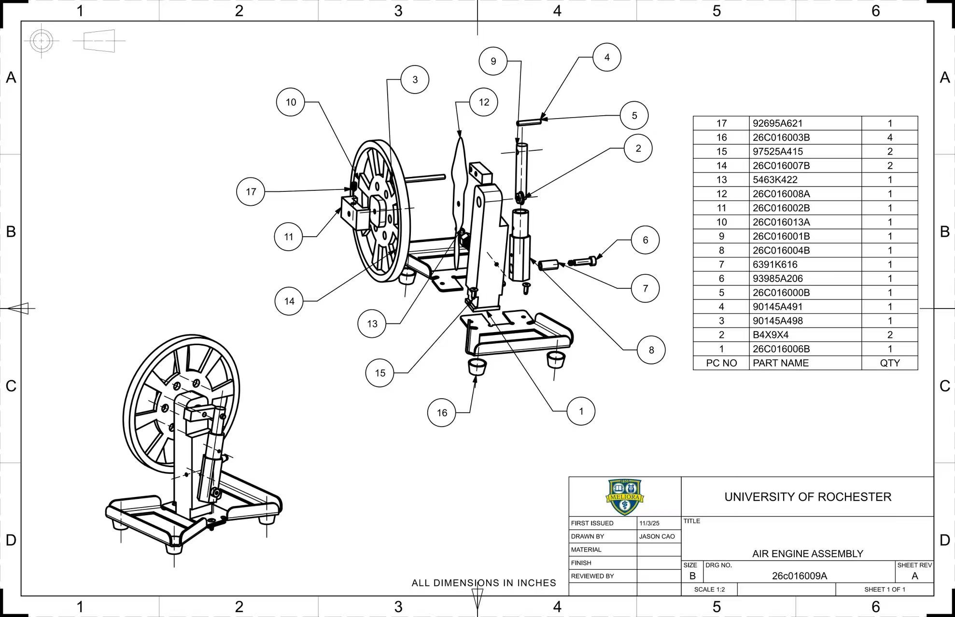
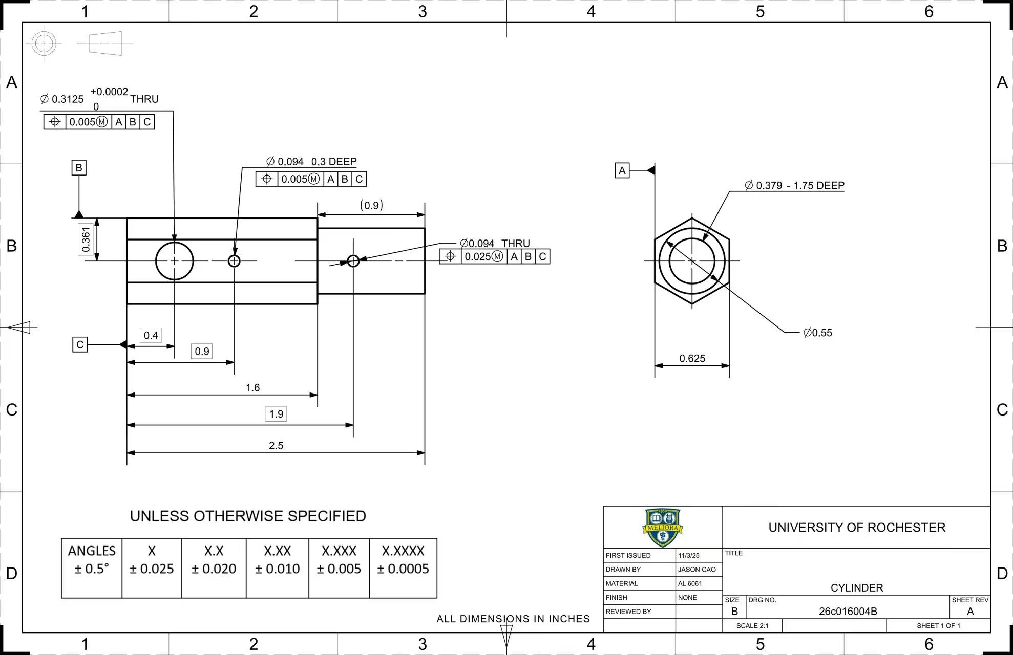
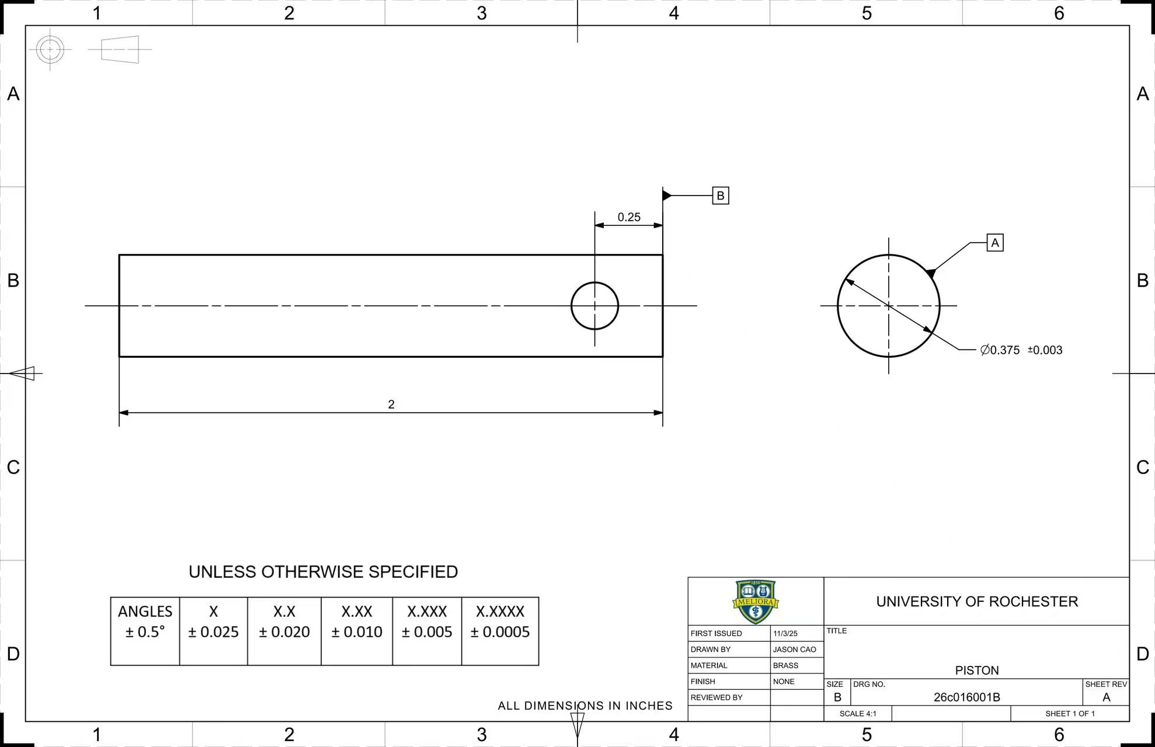
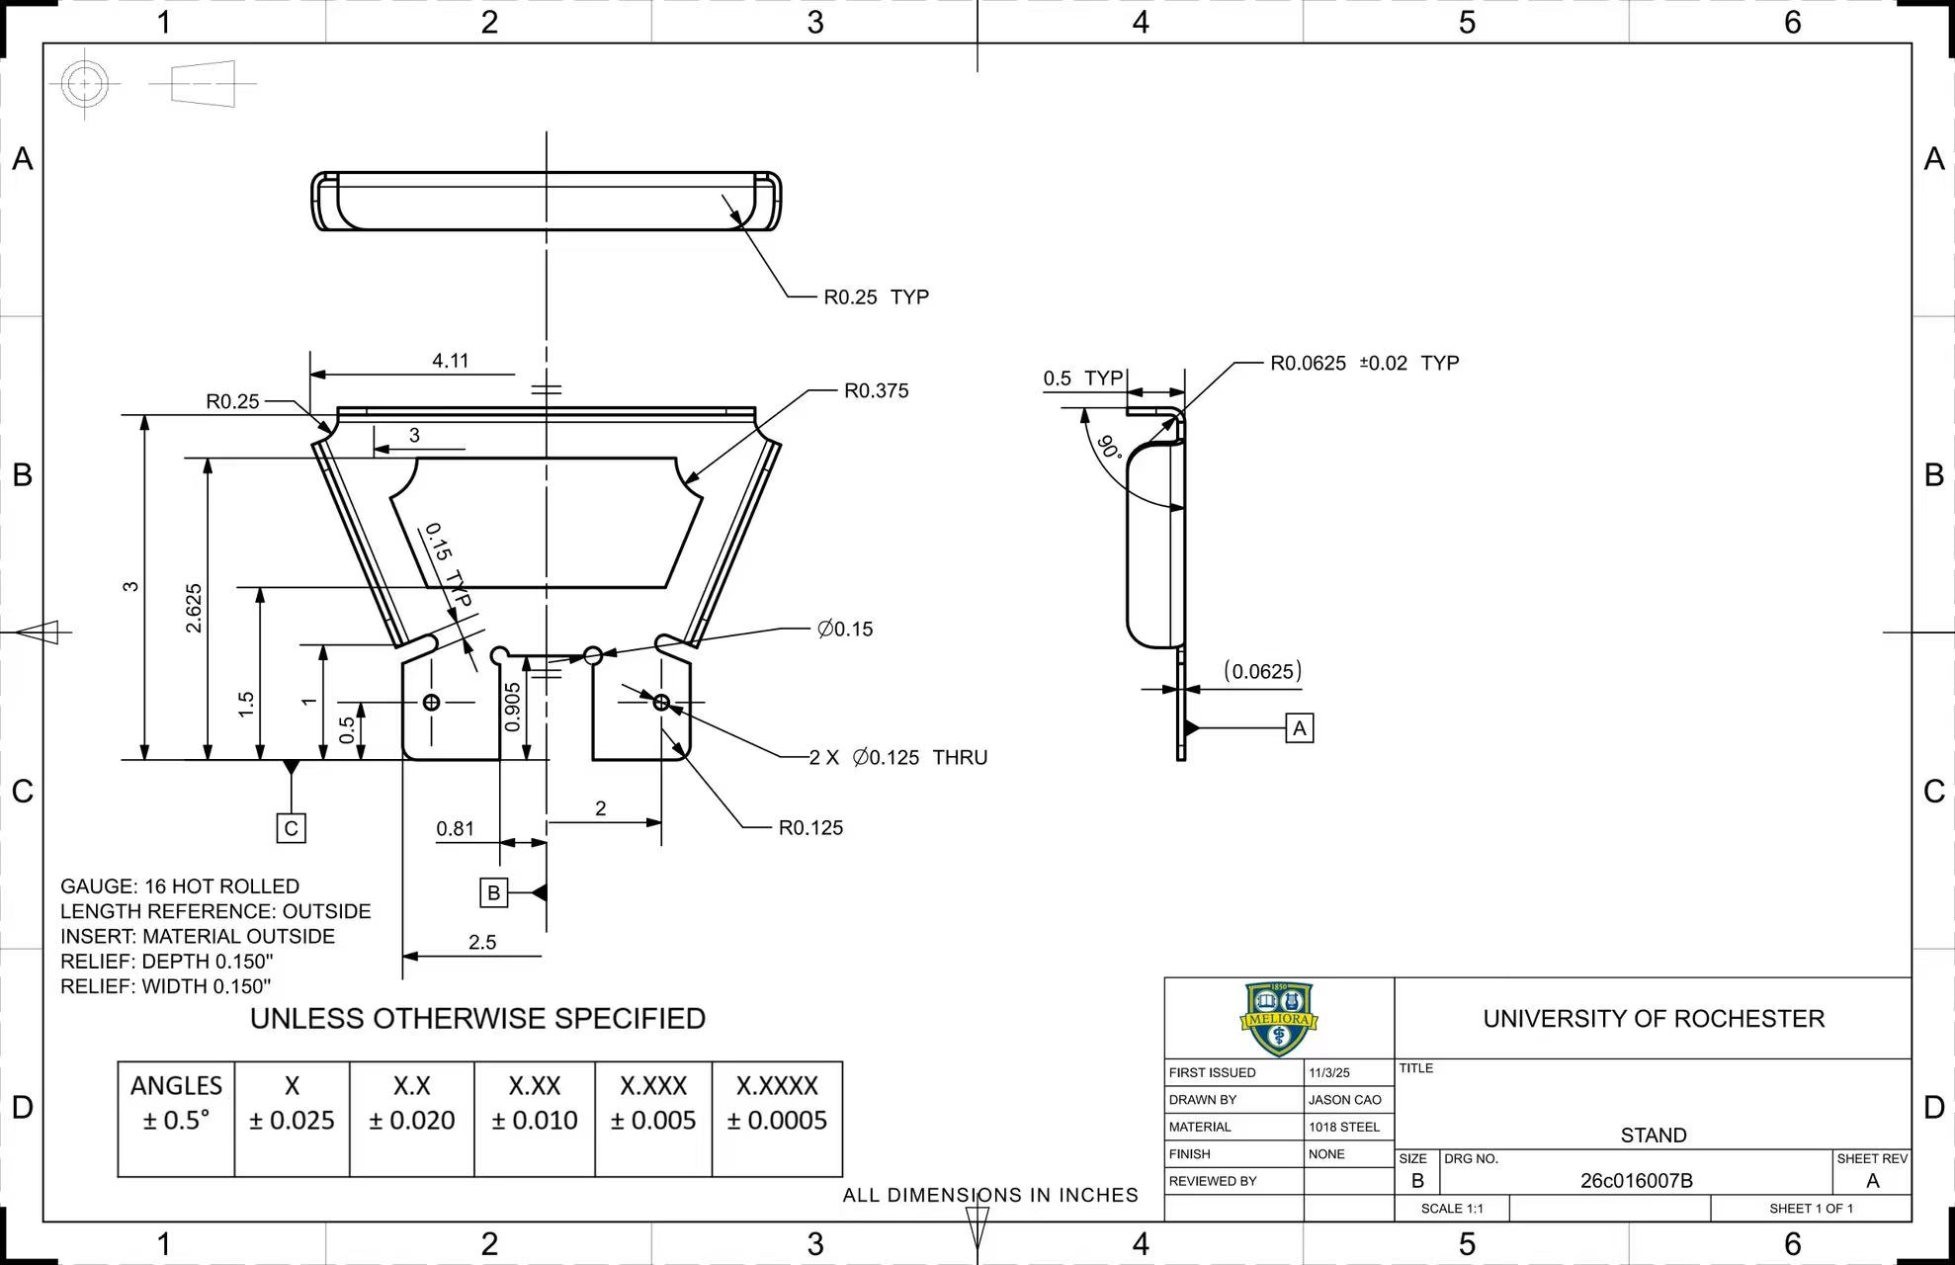
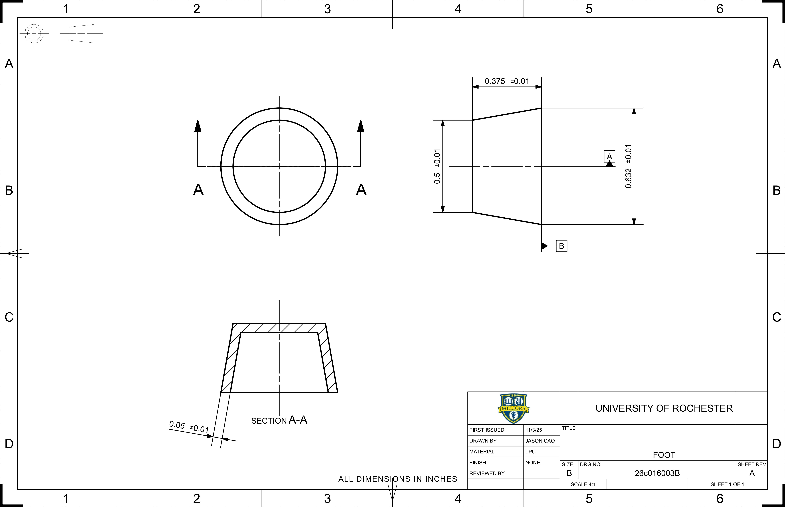
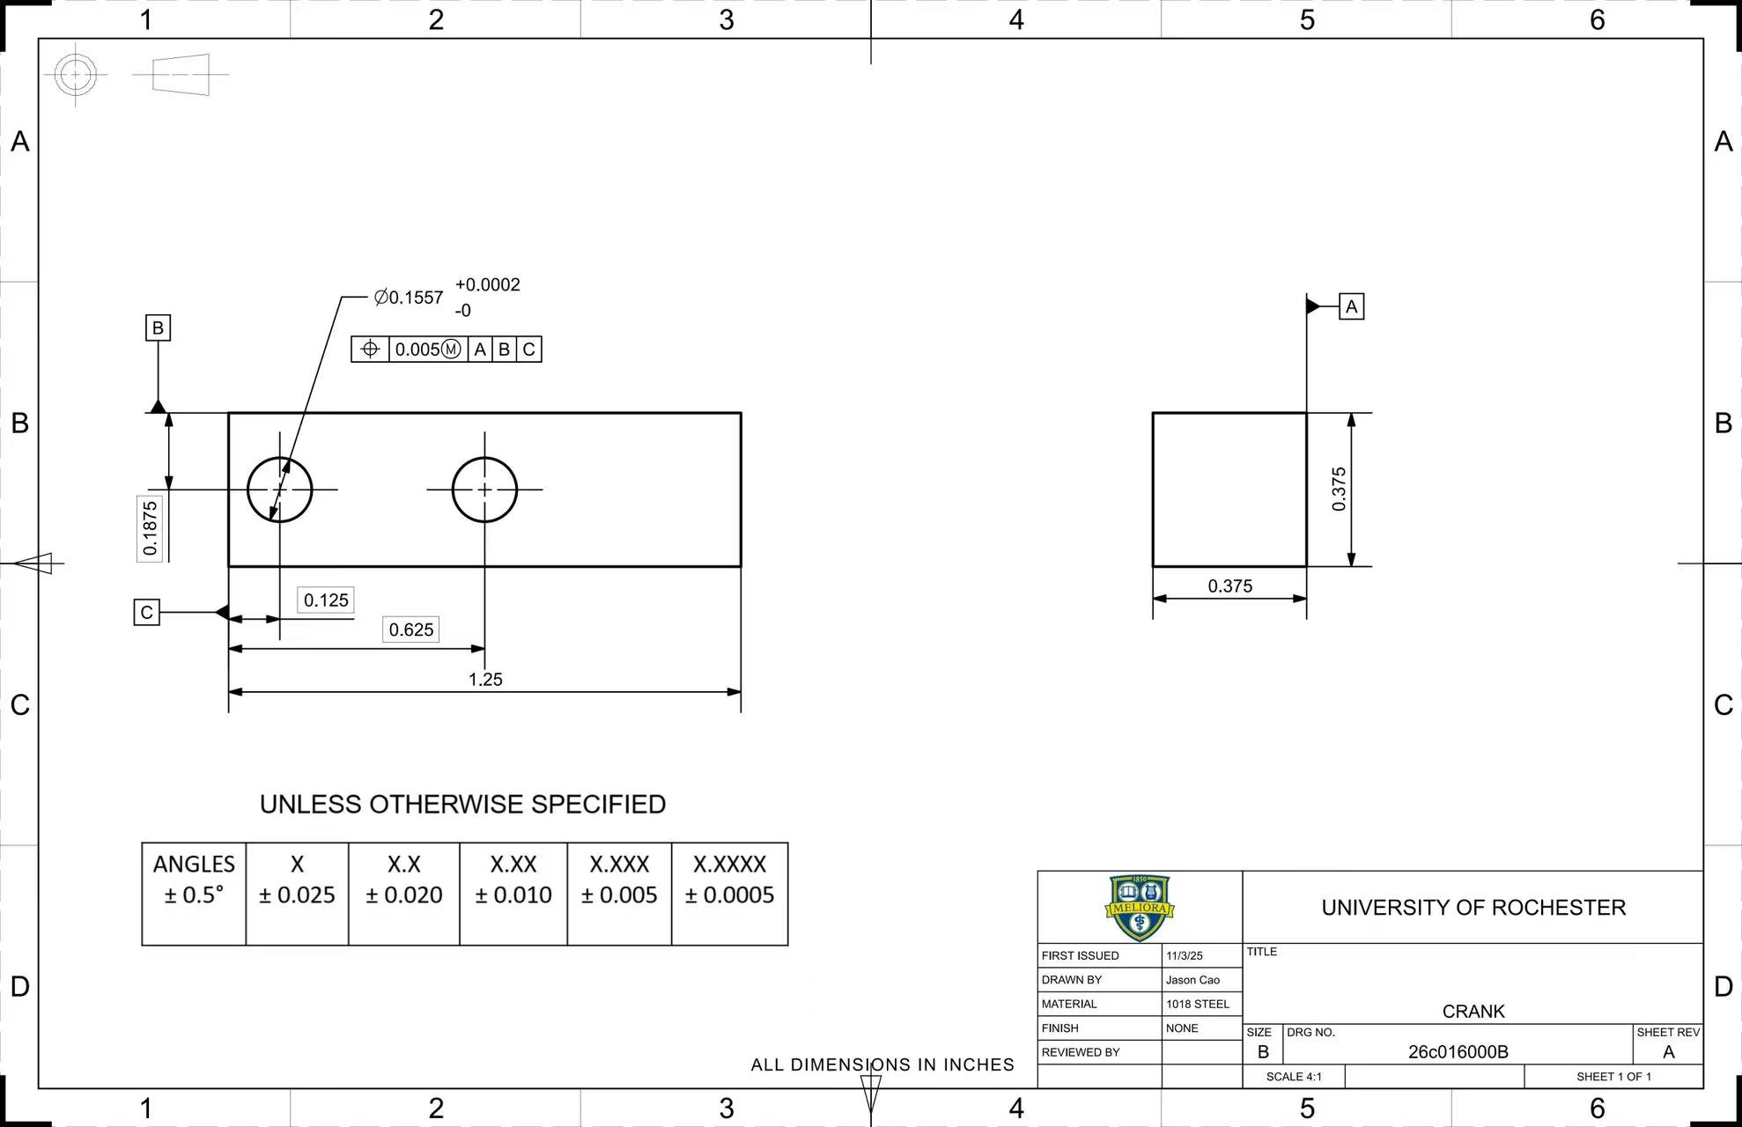
Jason Cao
Nov 17, 2025
Project 1 – Air Engine
Drawing Package

Slide 10
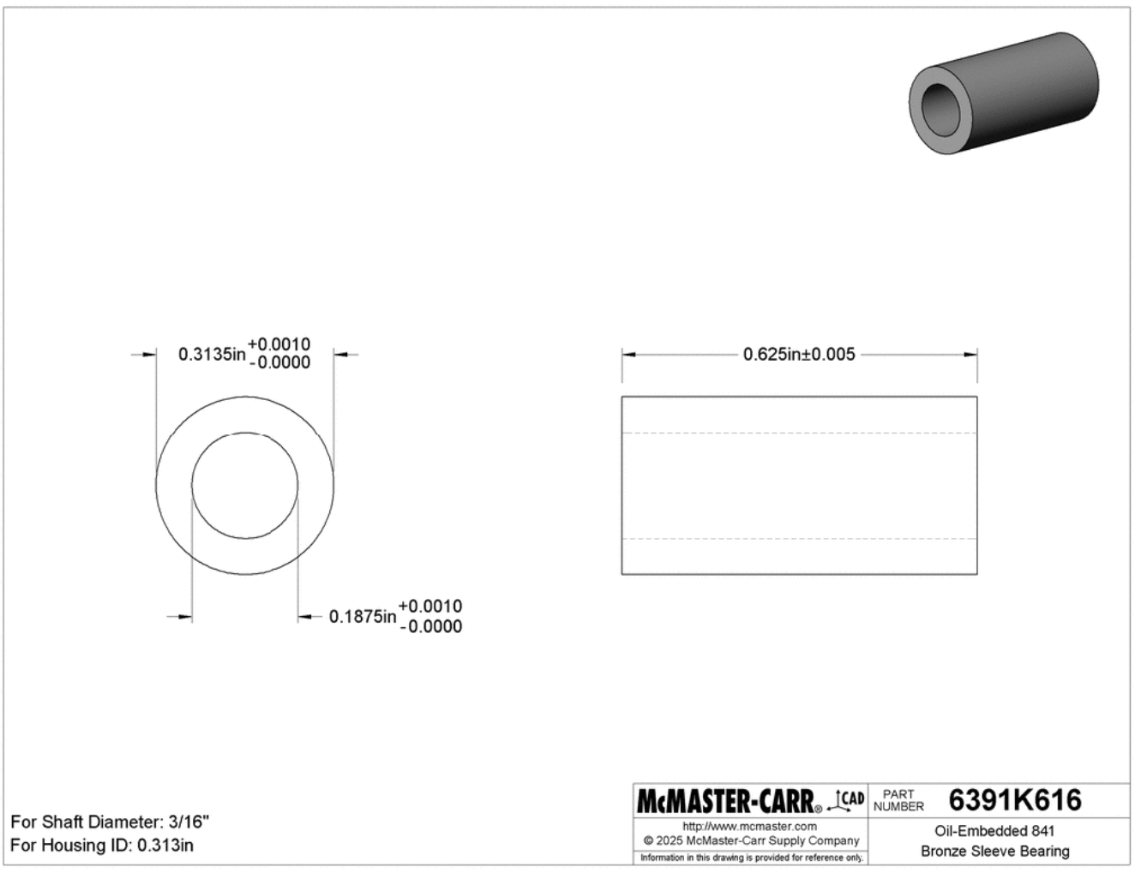
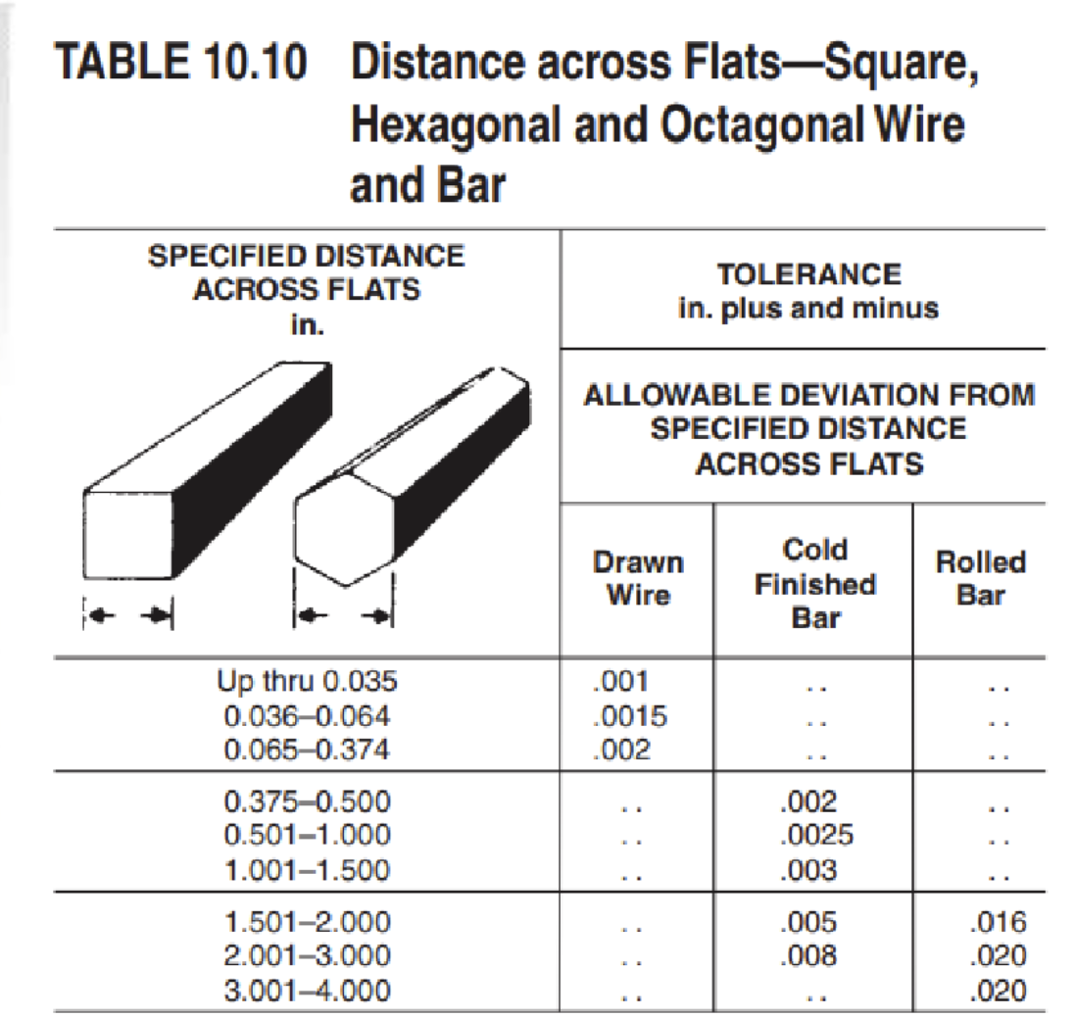
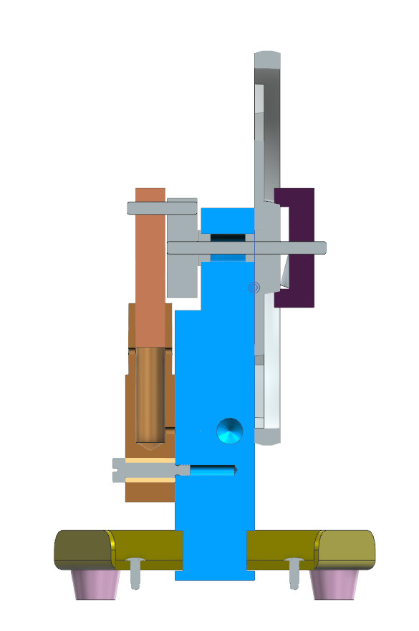
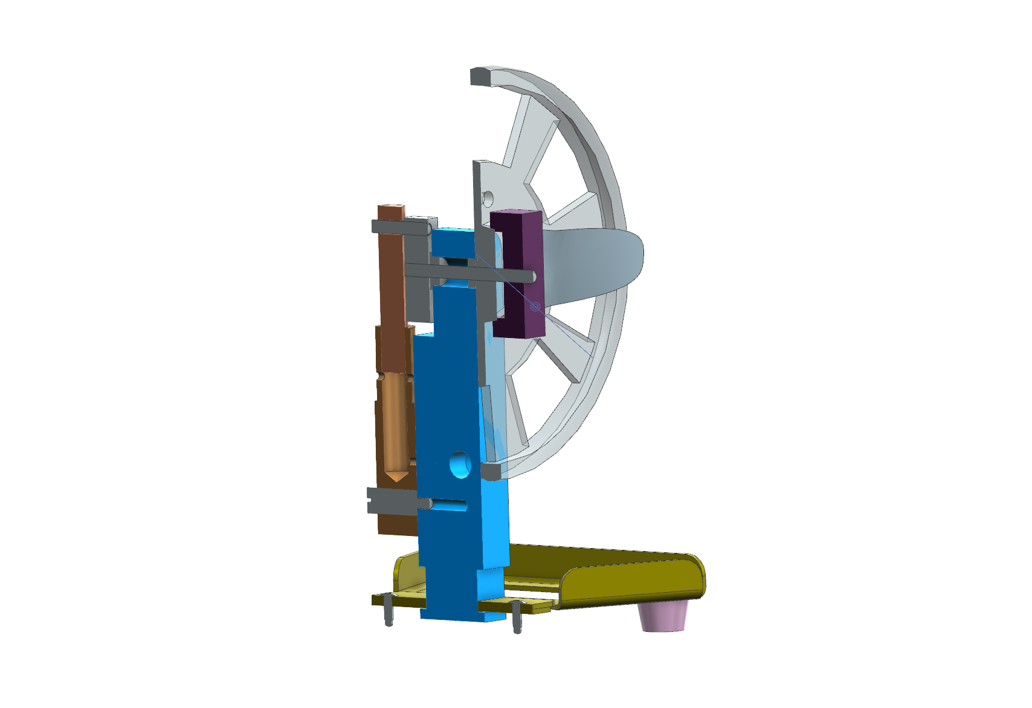
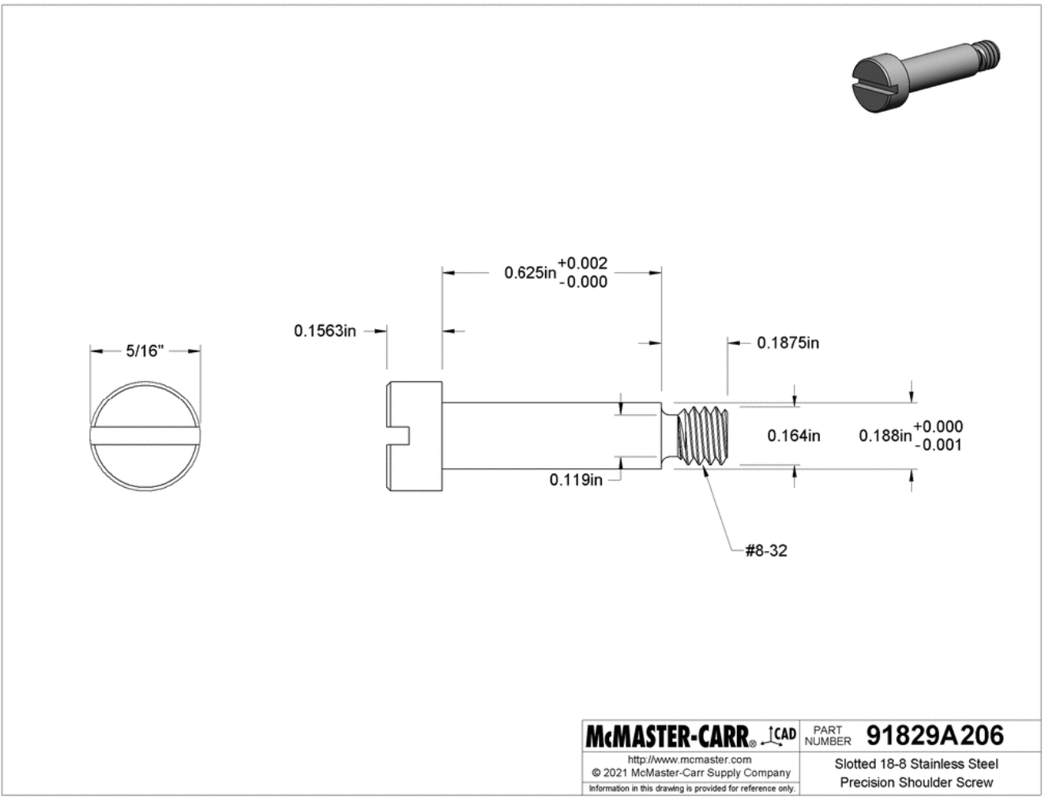

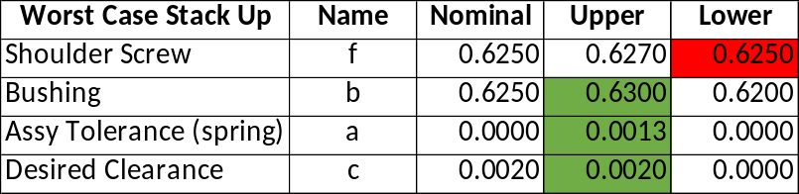
Jason Cao
Nov 17, 2025
Project 1 – Air Engine
Tolerance Stack Up
When I was assembling the rods to the crank, the rod was bended because the rod I used is slightly larger than the nominal size. I replaced the bended one to a new one and it works. Also, the dog doesn’t fit my flywheel, so I sanded the inner edges of the dog until they fit.
cylinder
fastener
Note: Parts were modified for fit at assembly.
bushing
Assy Tolerance Spring
backbone
Min shoulder length
0.633 bmax+a+c
Largest Hex size
Min washer required
0.0083 bmax+a+c-fmin

Slide 11
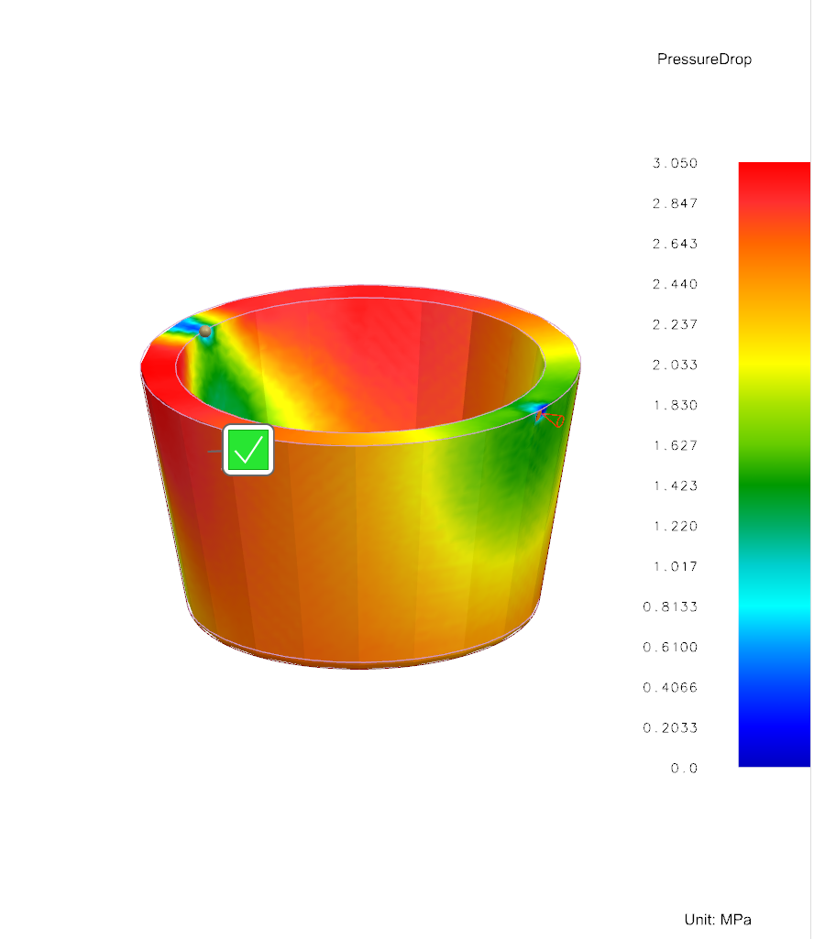
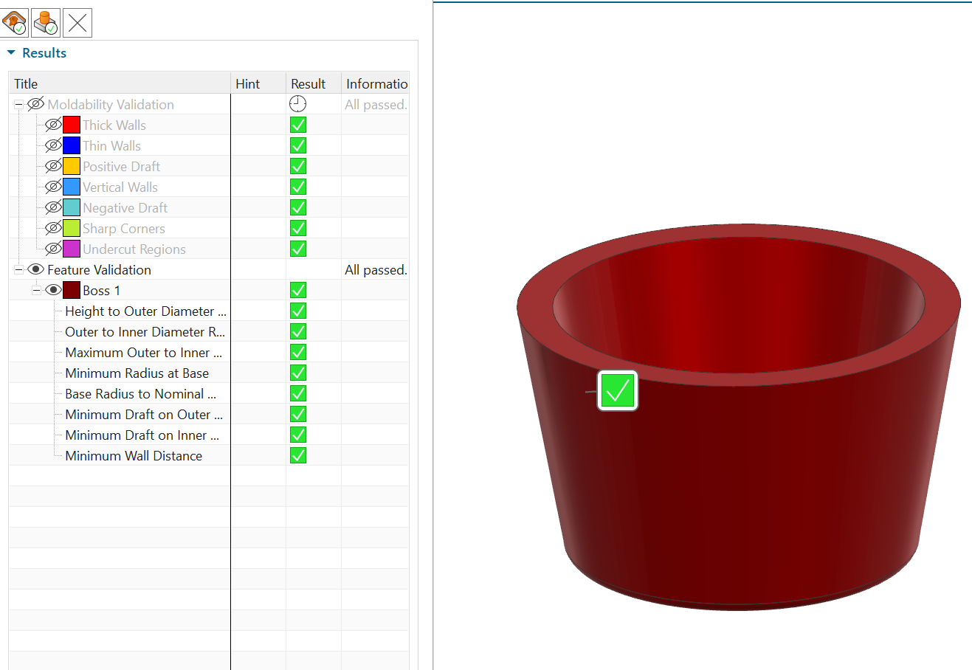
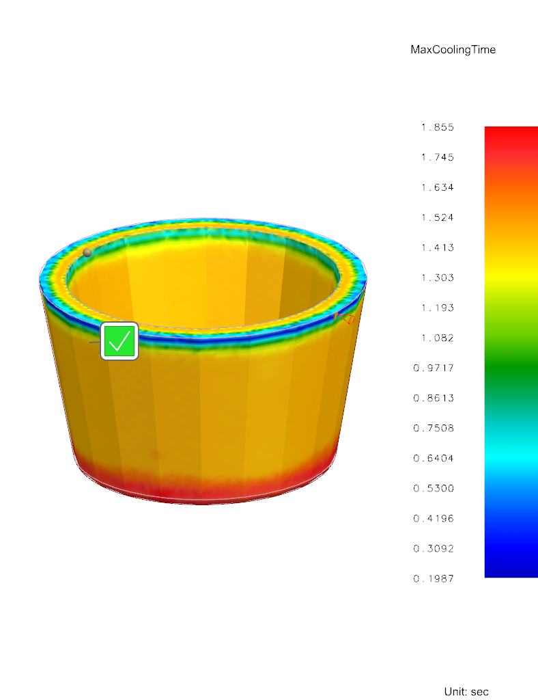
Jason Cao
Nov 17, 2025
Project 1 – Air Engine
Moldability Checks
Air Tap
Initial filling analysis shows no concerns
Gate
Radius added
Edge Blend r = 0.02 in

Slide 12
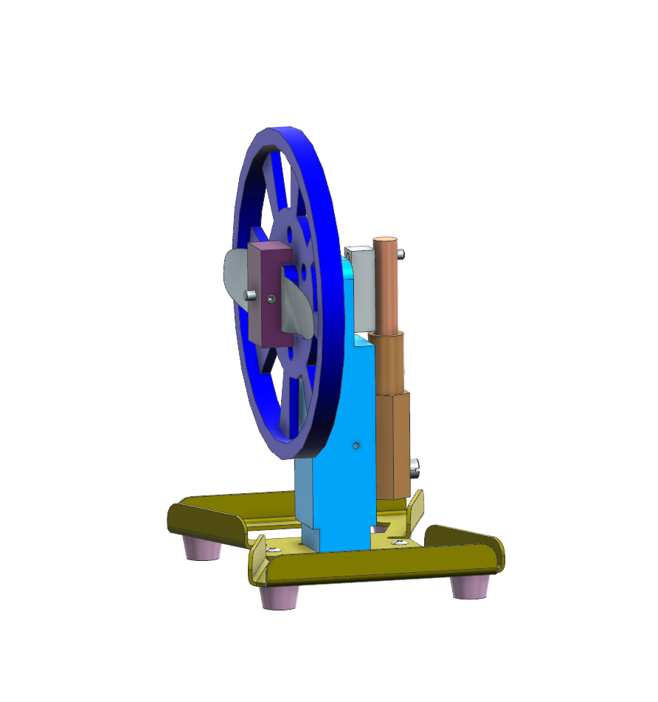
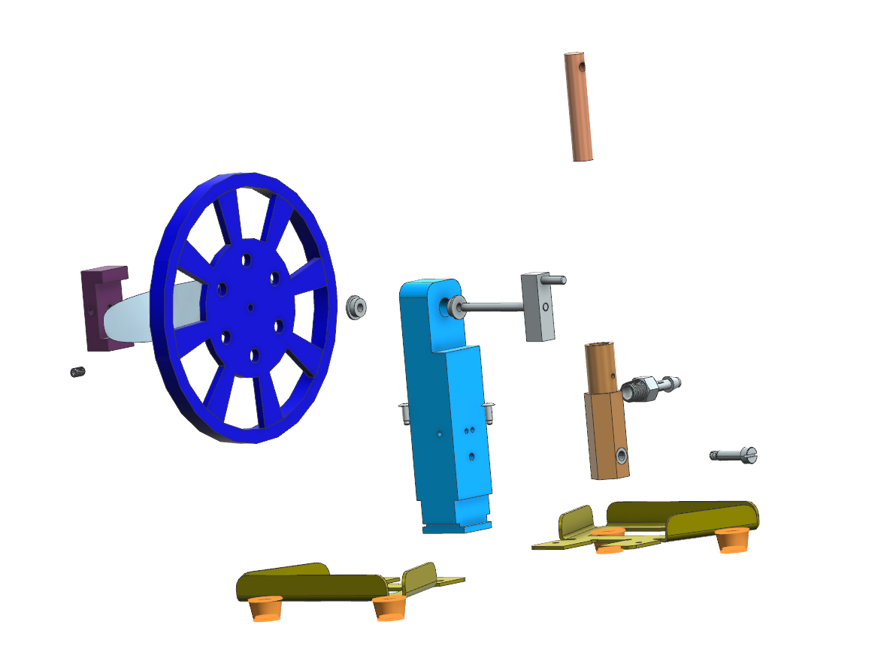
Jason Cao
Nov 17, 2025
Project 1 – Air Engine
Assembly Sequence
Assembly Start
Completed Assembly

