Slide 1
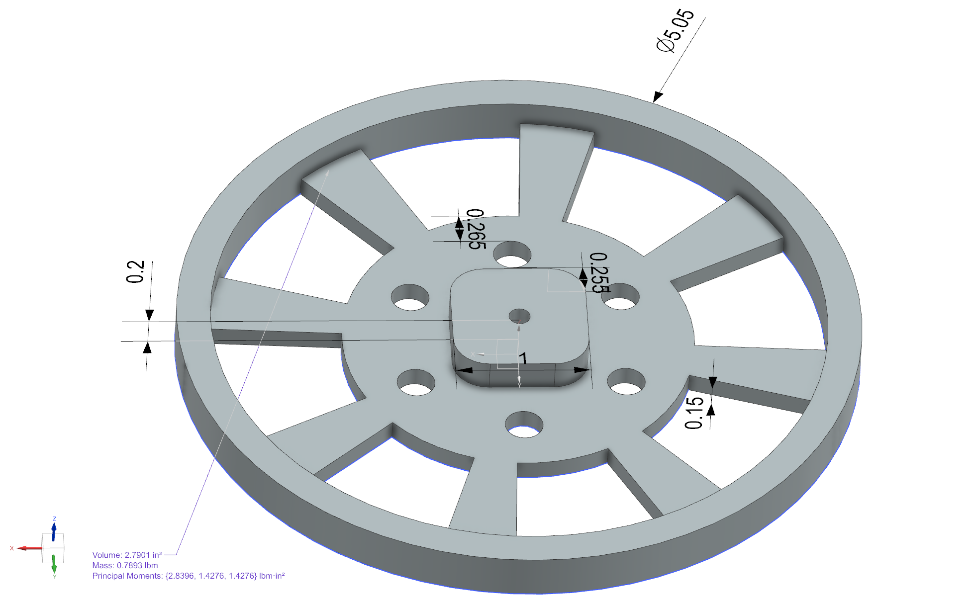
Project 01 – Mold
Jason Cao
9/18/25
Verify required parameters for flywheel

Slide 2
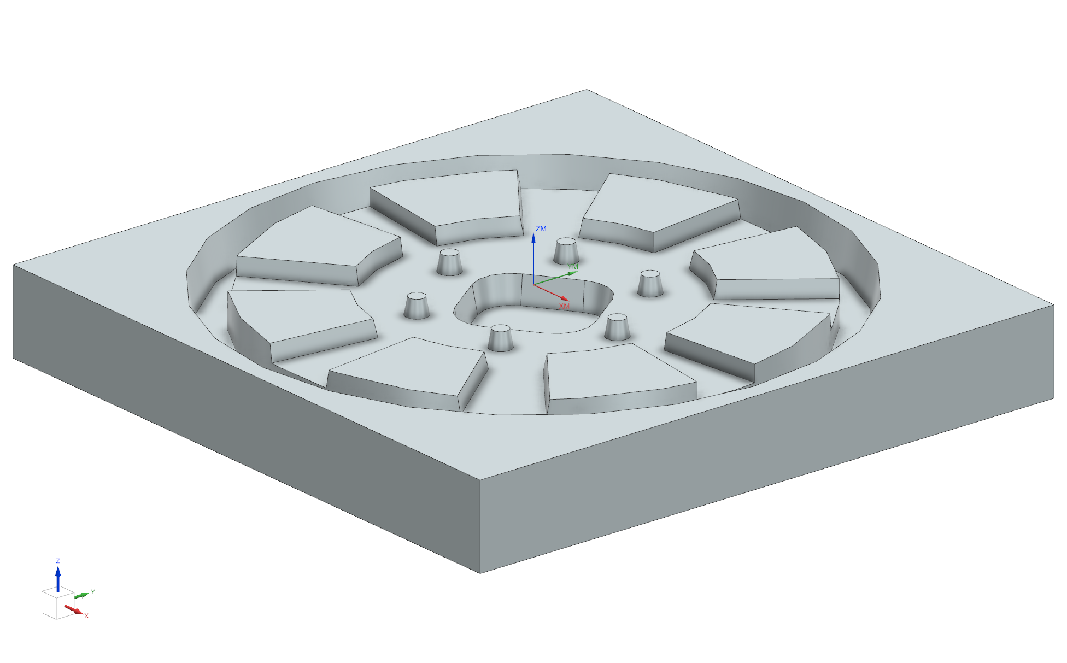
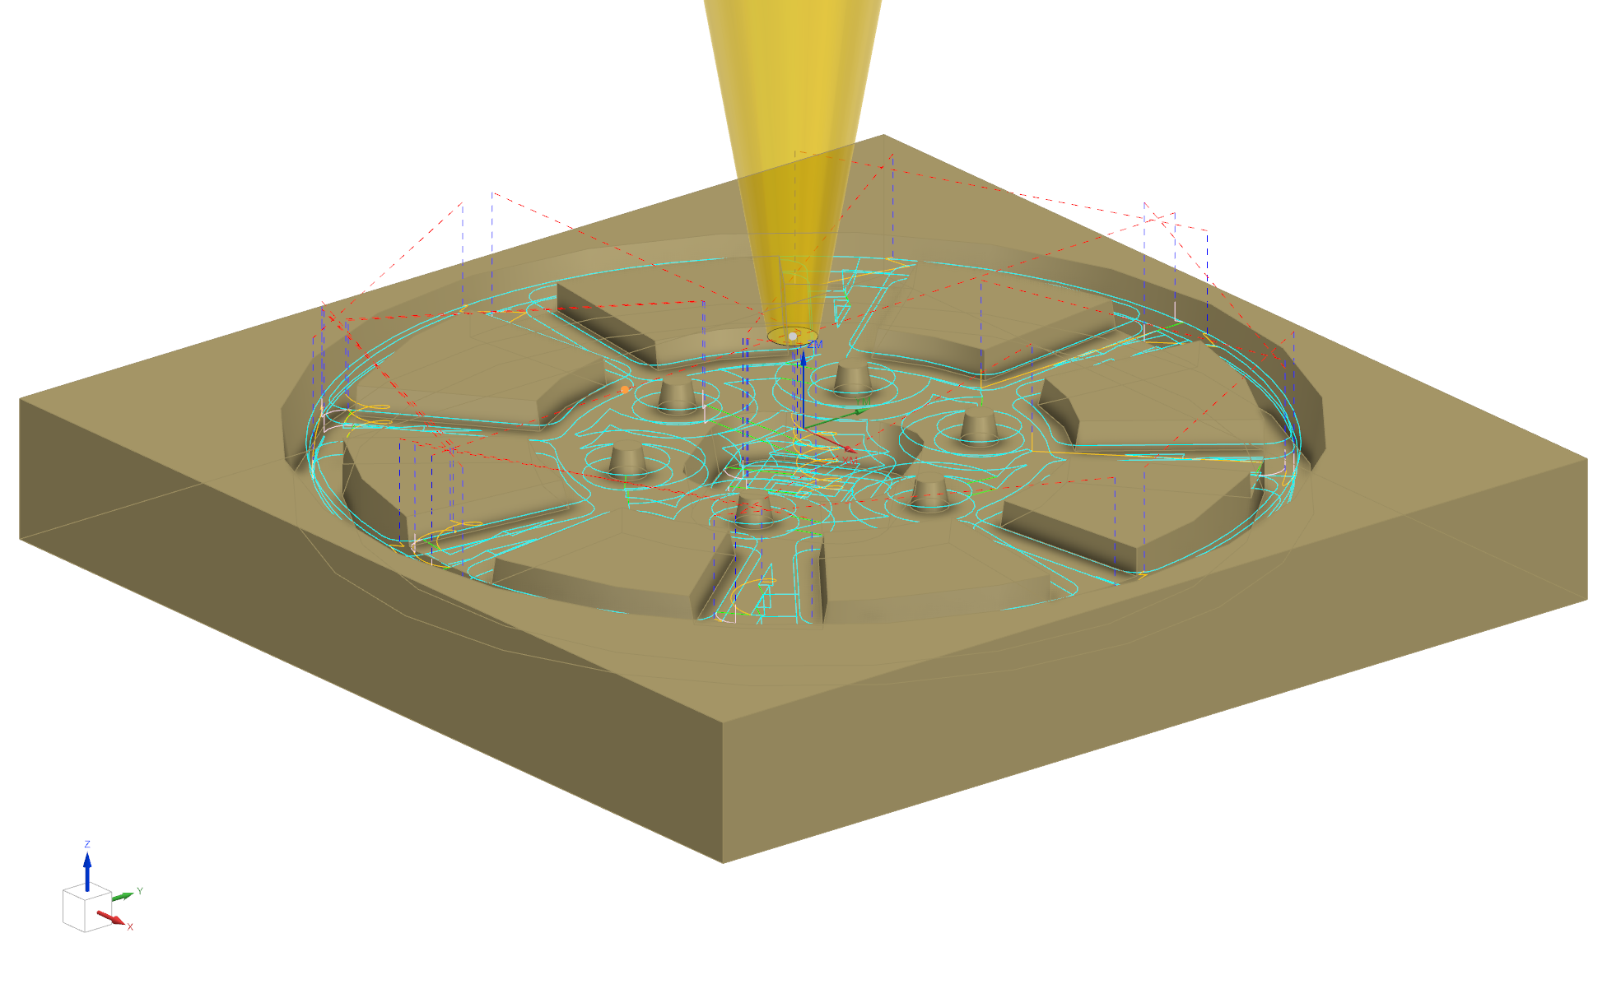
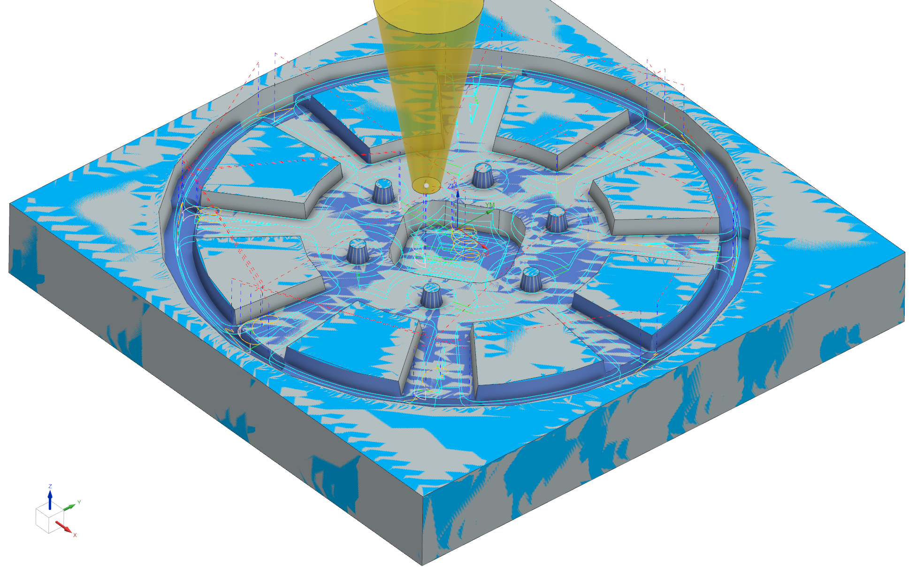
Date:9/18/25
Name: Jason Cao
Tool: 0.25x10Deg Taper
Stock: 5.5x 5.5 x0.75 Oak
Description: Mold Cavity
Part Reference: 26c016014A
MCS centered on top
Output from:
Program Data
Program Run: 09/18/2025 10:45:55
Linear Move Envelope:
X: -2.425 2.455
Y: -2.442 2.455
Z: -0.390 0.500
Maximum Feedrate: 50.000
Maximum Spindle: 16000.000
Minimum Z at Rapid: -0.250

