Slide 1
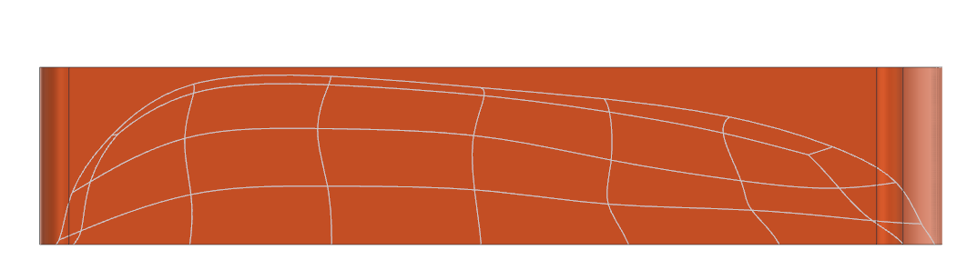
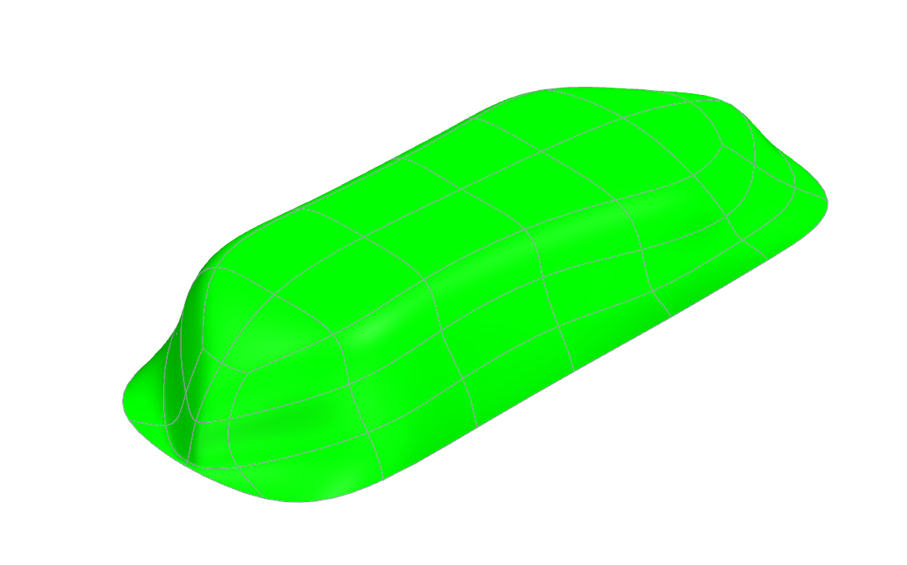
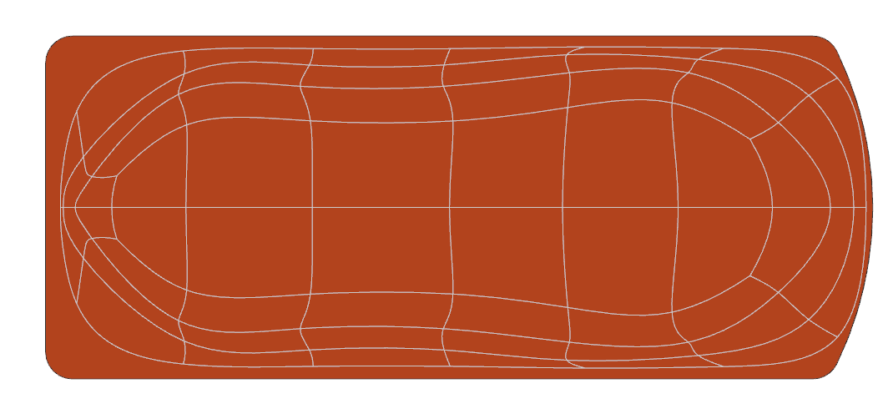
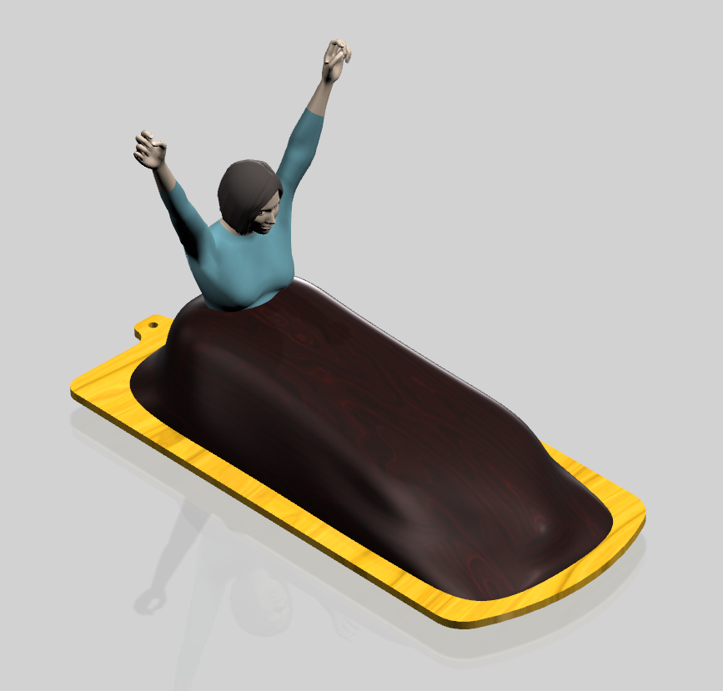
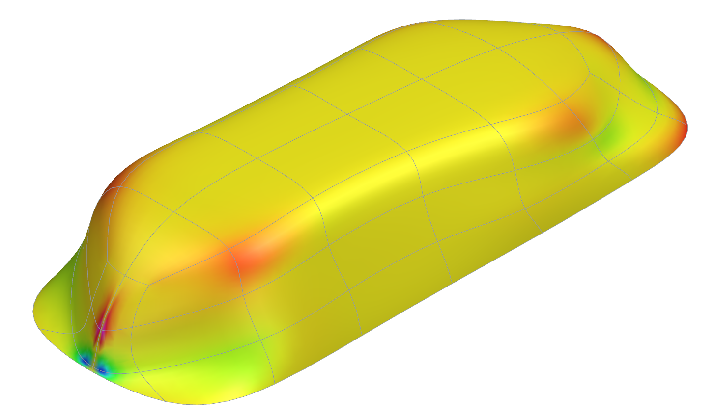
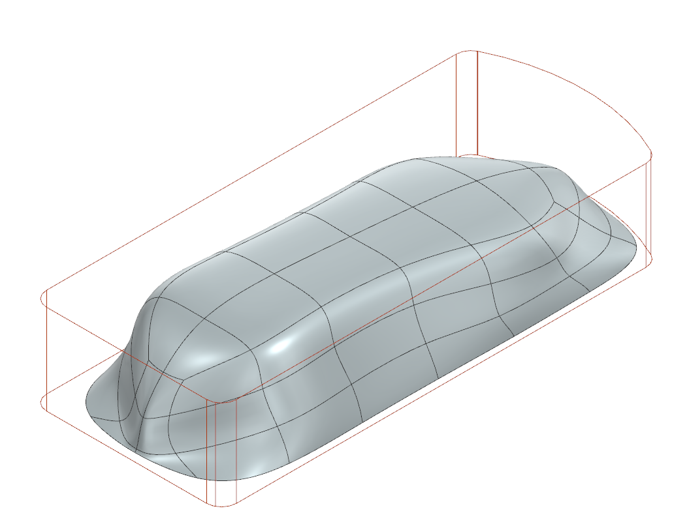
Project 1, Team ALD (Lowe), Item 1
Body in Envelope Analysis Rendering
Drafting Analysis
Curvature Analysis

Slide 2
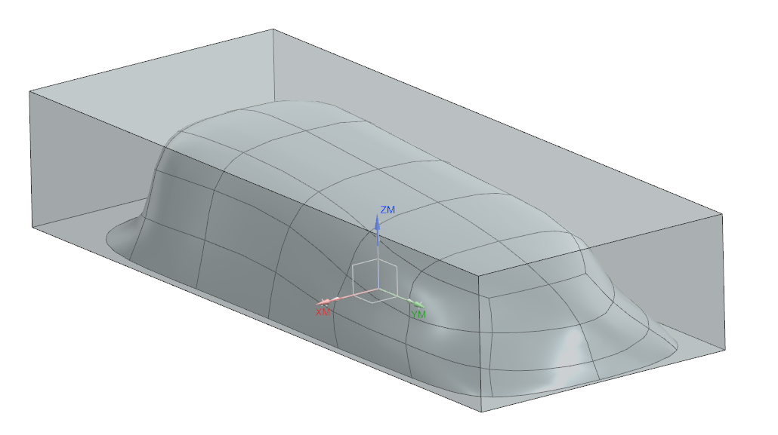
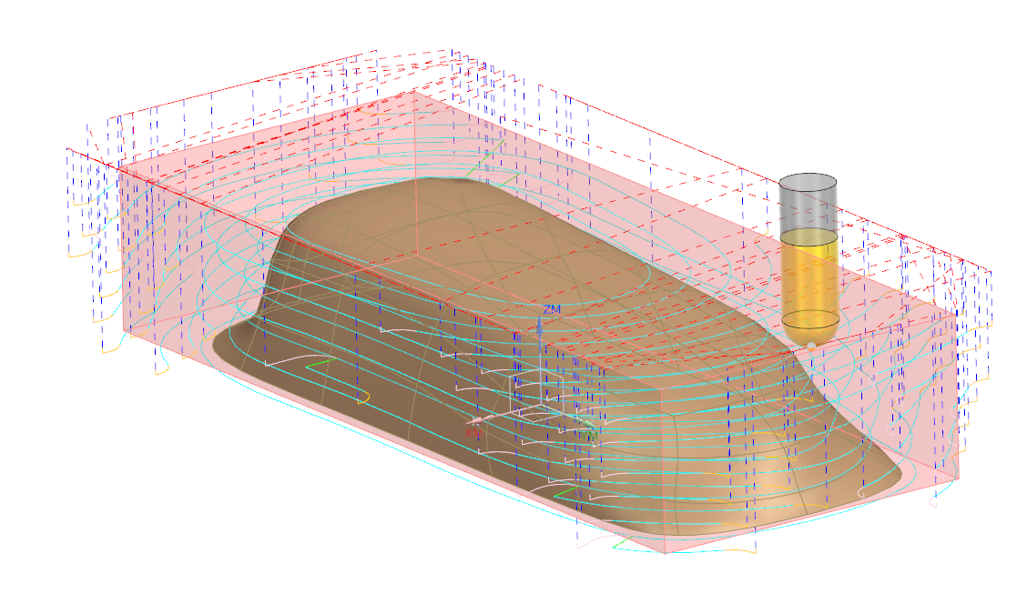
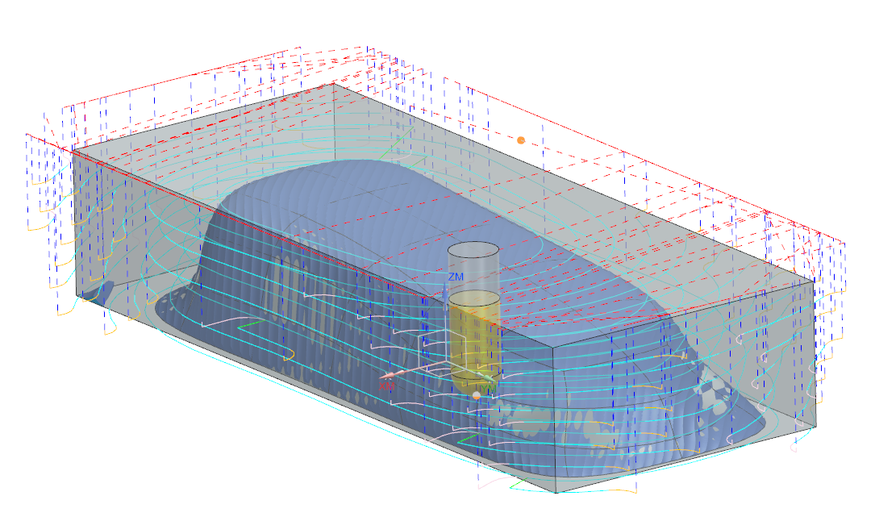
Project 1, Team ALD (Lowe), Item 2
Date: 2/12/26
Name: Lowe
Tool: 1" Ball
Stock: 6.4" x 14.1" x 3"
Description: Mold for Body
Part Reference: 26c043357A
MCS
Center Bottom
Feed Rate 50 ipm
Scallop Height 0.025"

Slide 3
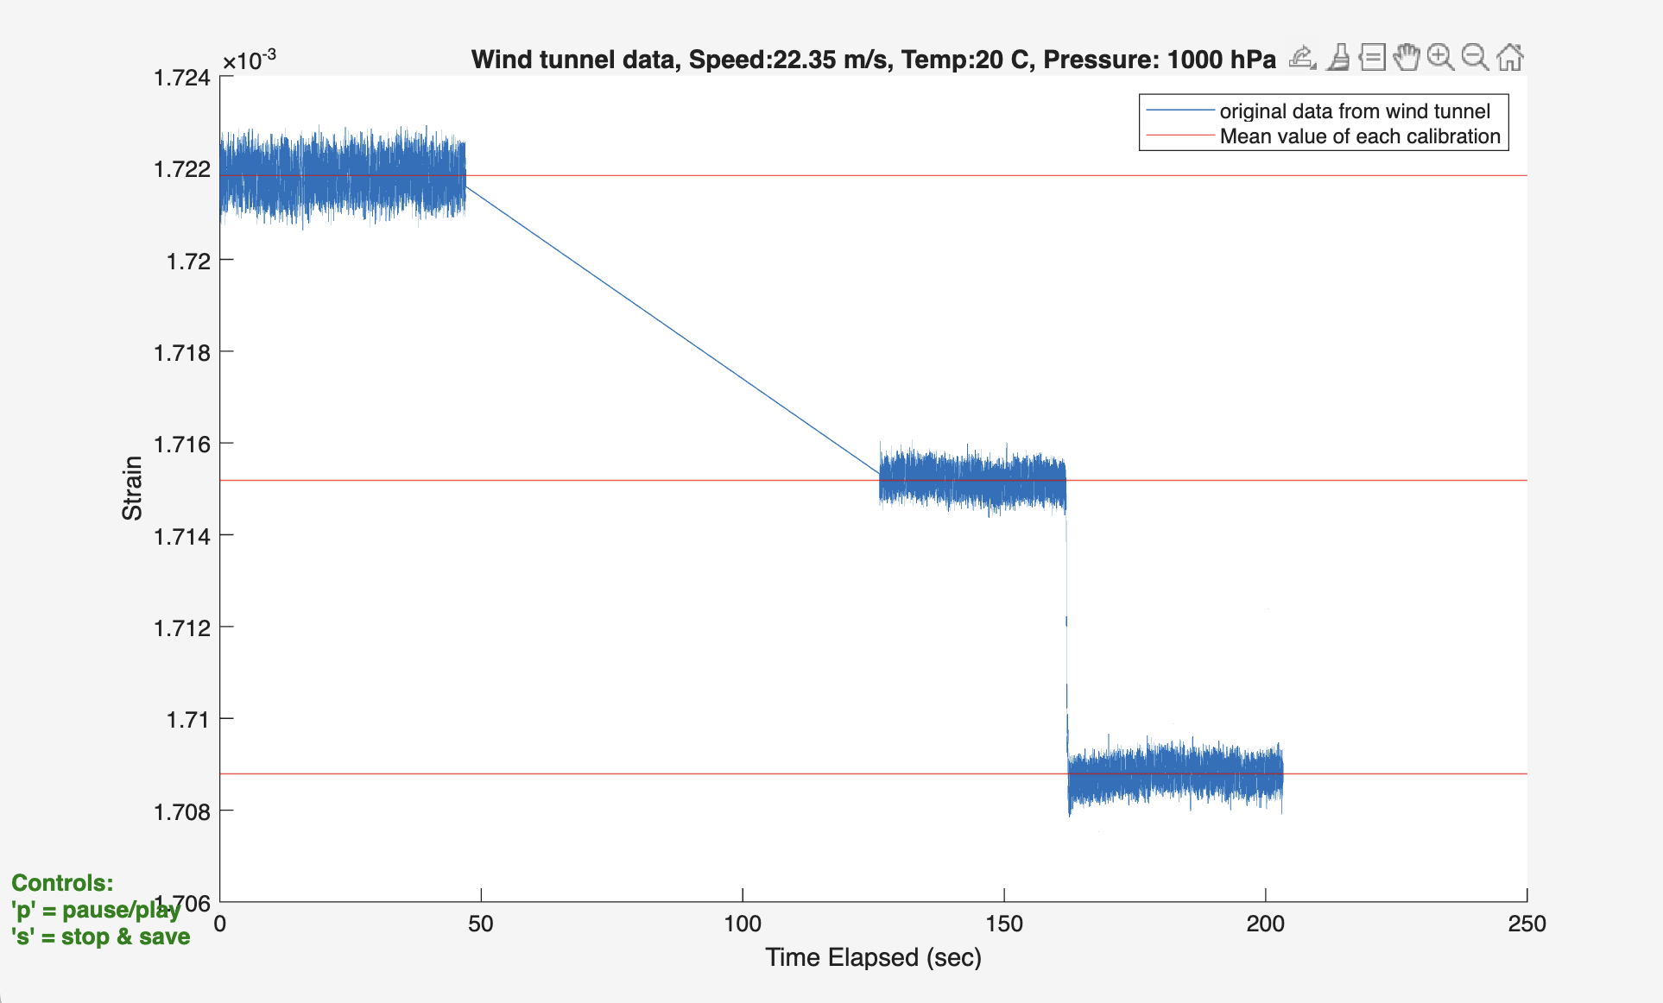
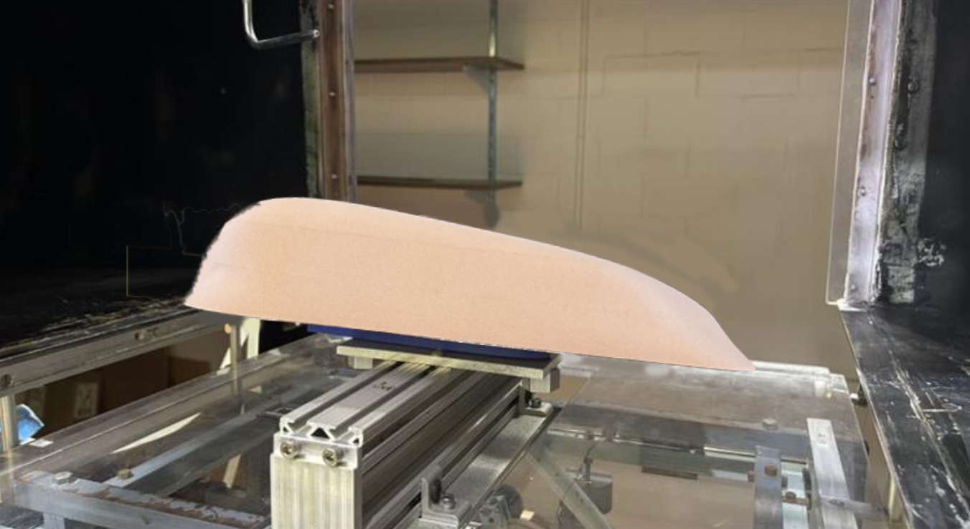
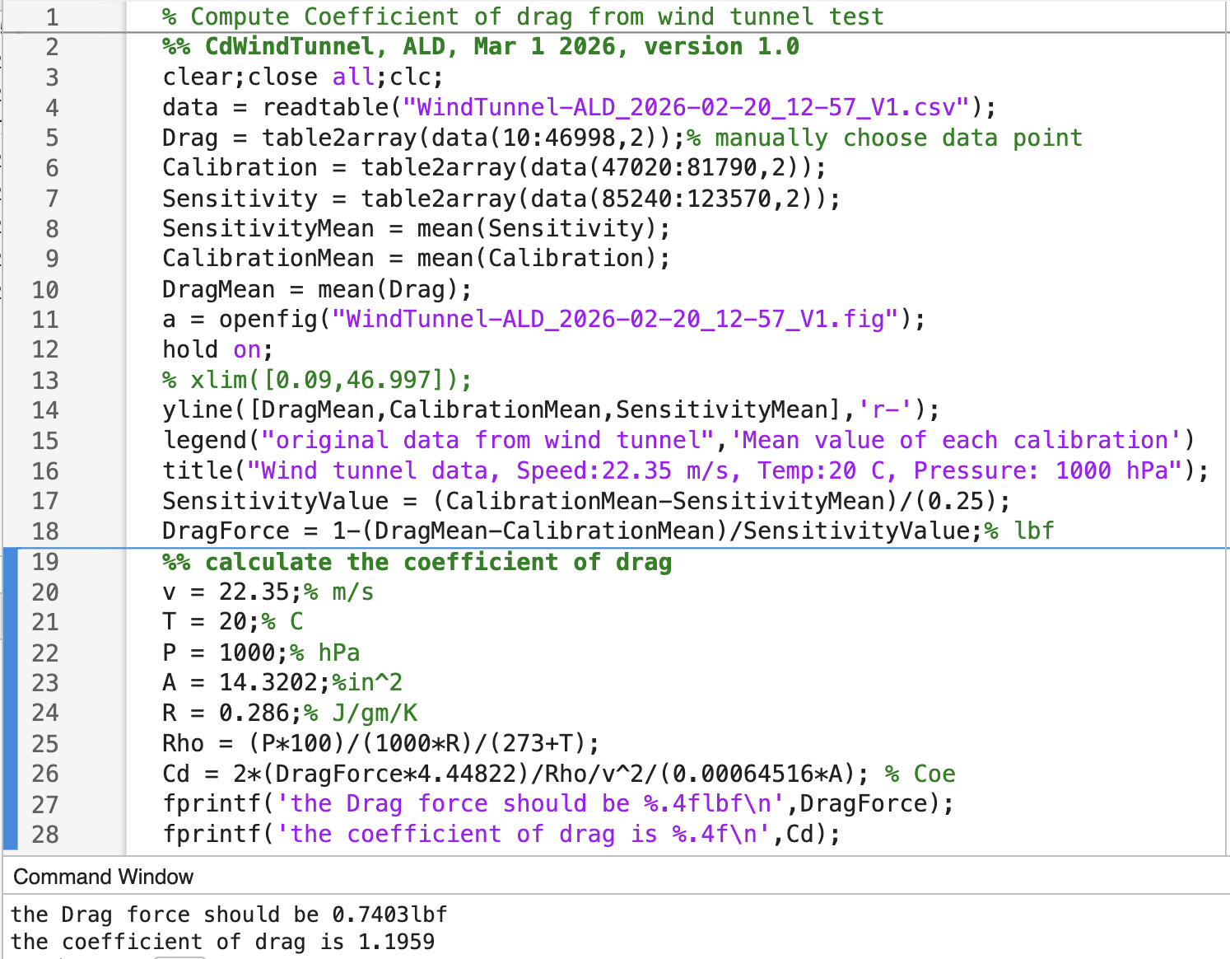
Project 1, Team ALD (Jason), Item 3
The test results mismatch the simulation results because the velocity in the wind tunnel is 50mph. What's more, the weight connected to the strain gage vibrated all the time causing a different result.

Slide 4
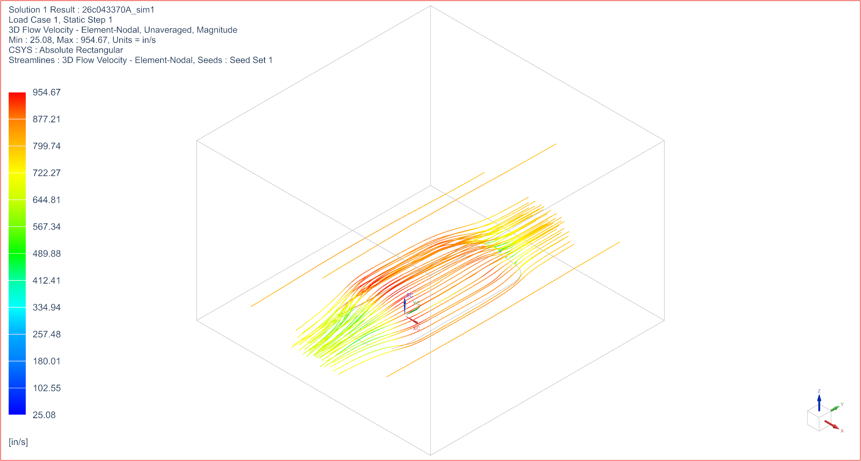
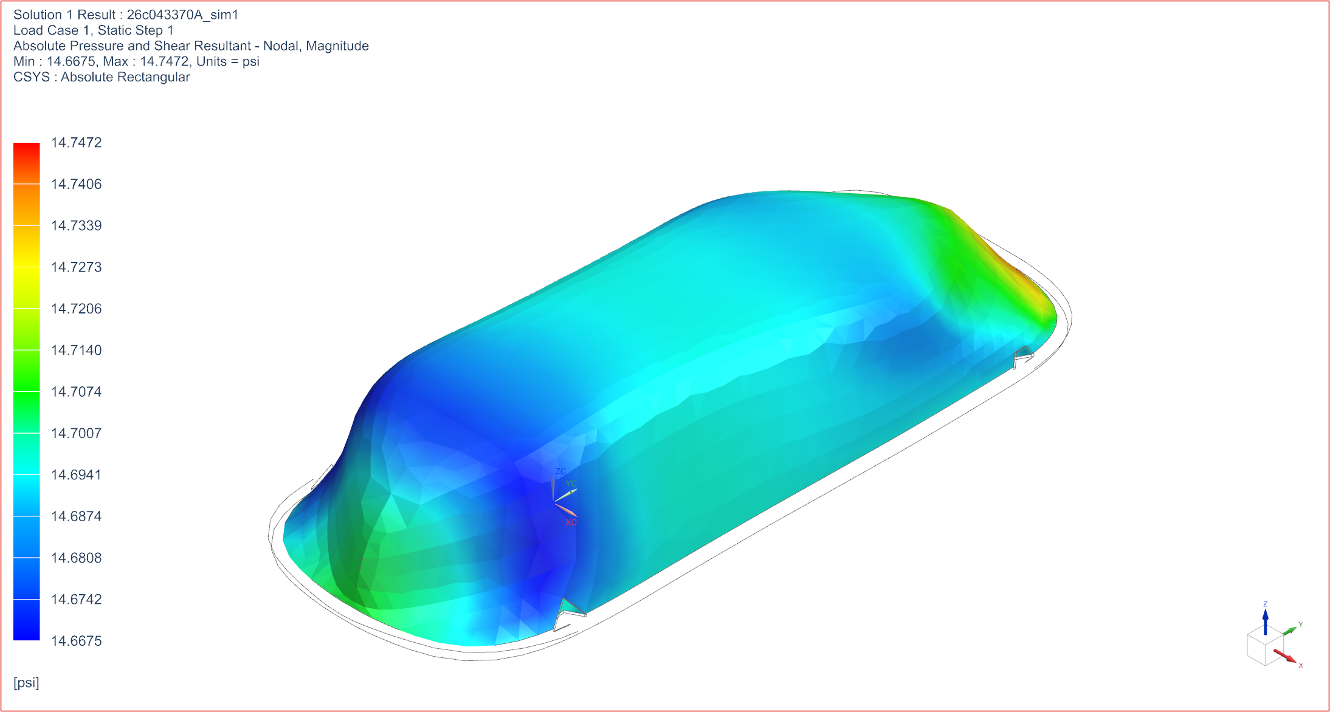
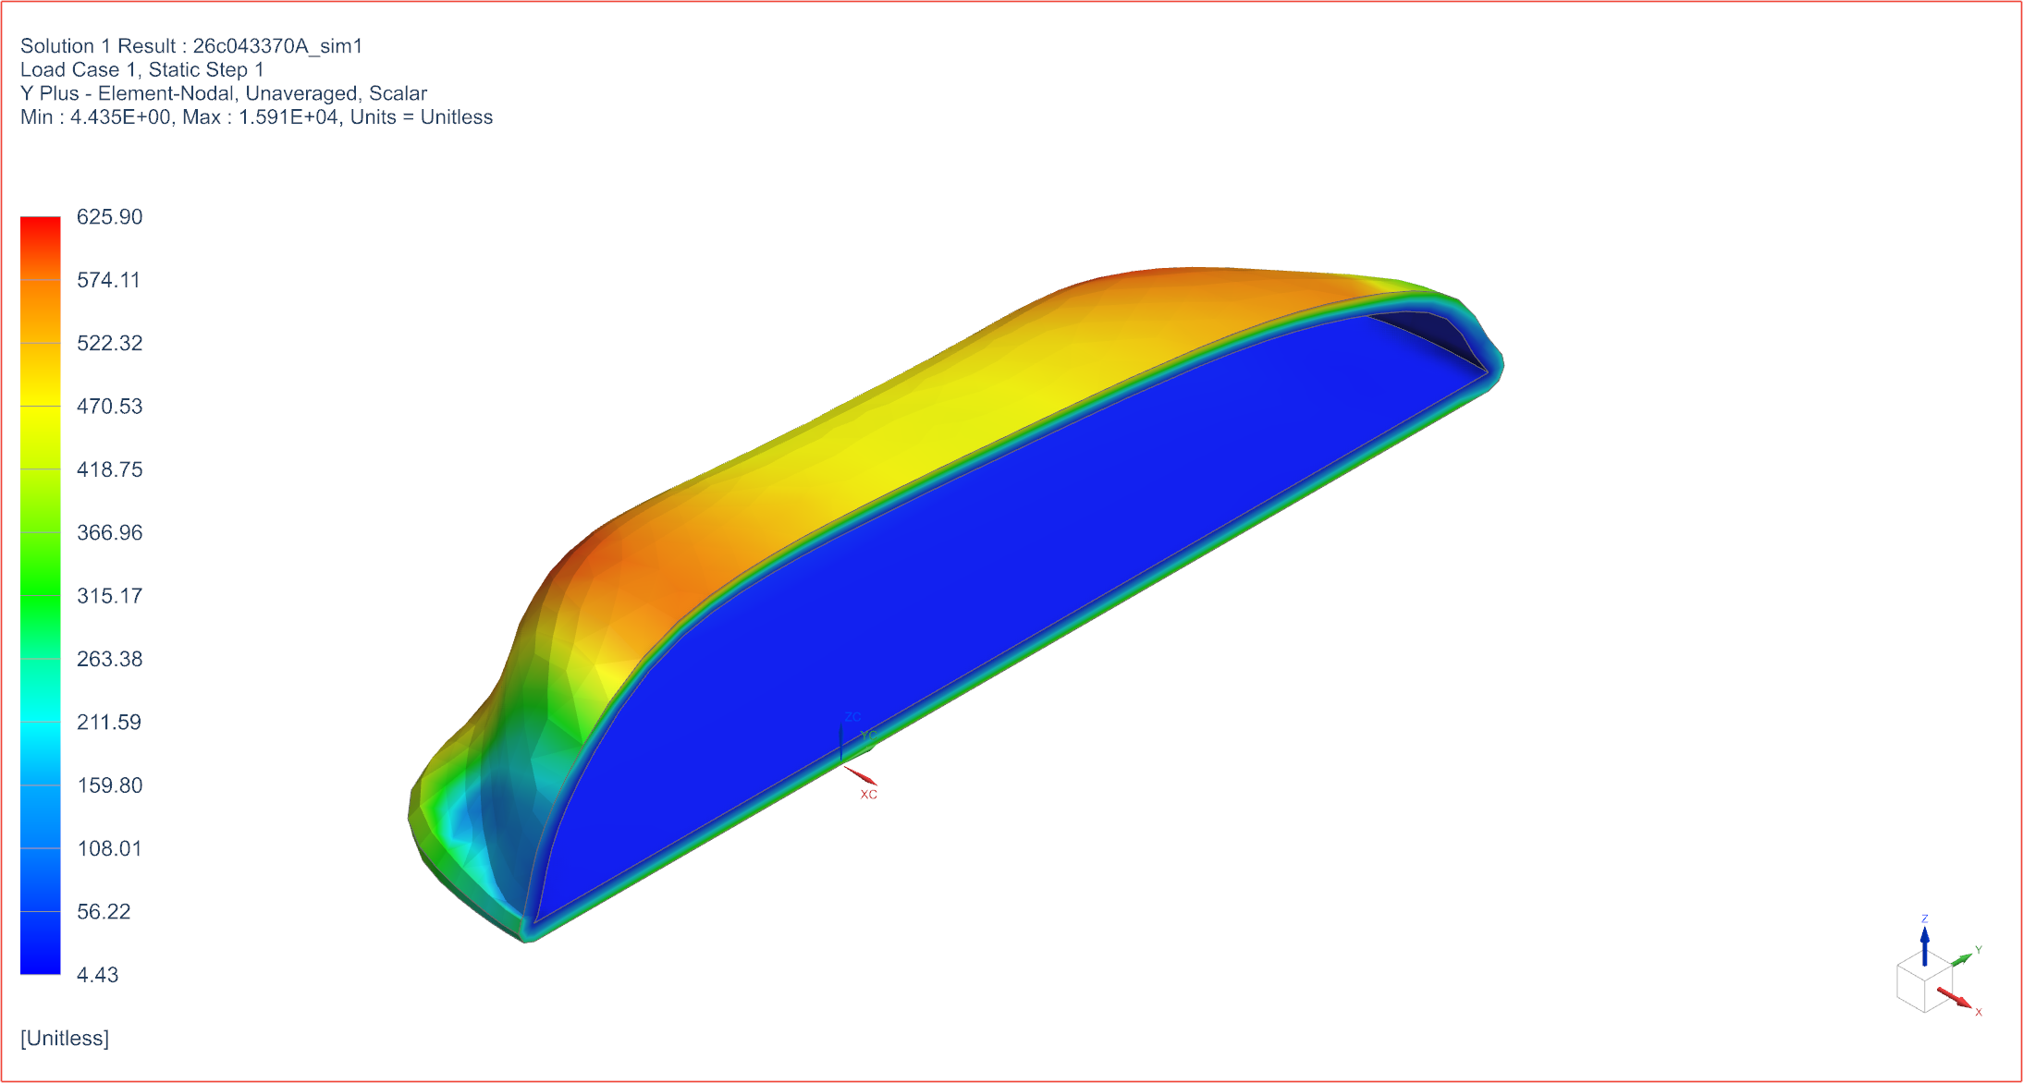
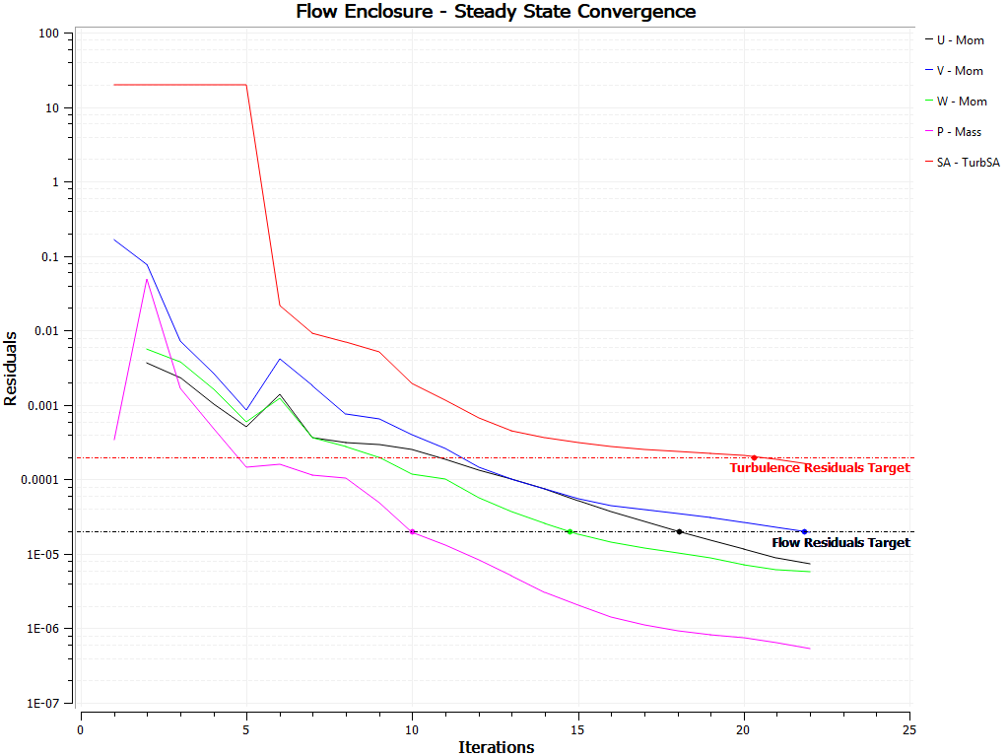
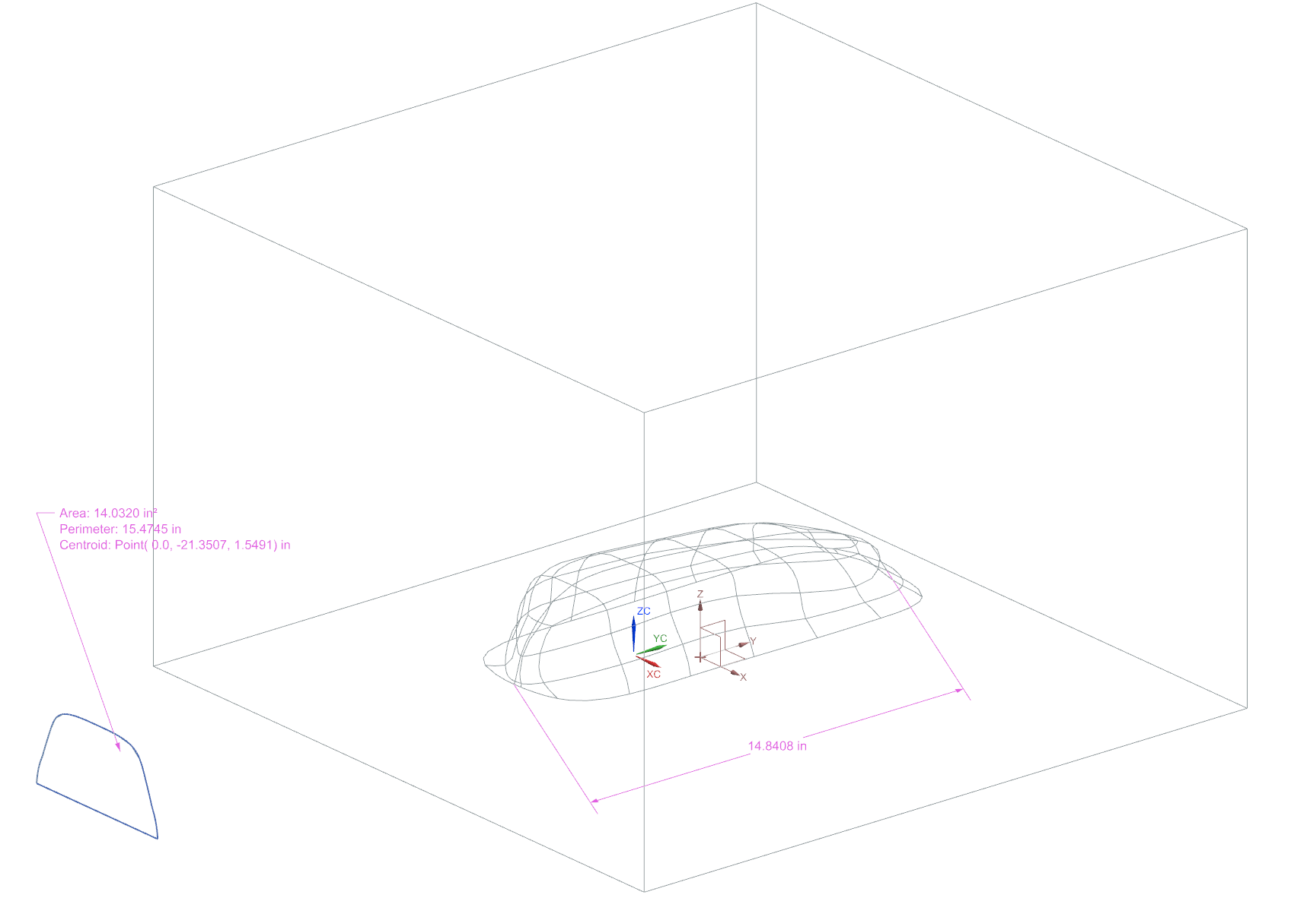

Project 1, Team ALD (Lowe), Item 4
Opening
Solver type: Simcenter 3D Thermal/Flow
Analysis type: Flow
Solution type: Advanced Flow
Simulation File: Z:\205\P1\26c043370A_sim1.sim
Solution: Solution_1
Number of nodes in thermal model: 0
Number of elements in thermal model: 0
Number of nodes in flow model: 55281
Number of elements in flow model: 271149
Number of fluid nodes reused for surface coating: 5083
Number of elements created for surface coating: 9838
Solution Options
----------------
Steady-State Analysis
Solving Flow and Thermal
Ambient Temperature: 6.800E+01 F
Ambient Pressure: 1.470E+01 lbf/in^2
Gravitational Acceleration: 3.862E+02 in/s^2
Gravity Direction: X: 0.000E+00 Y: 0.000E+00 Z:-1.000E+00
Fluid buoyancy: Off
Flow solver type: Parallel
Parallel flow solver scheme: Fully Coupled Pressure-Velocity
Flow laminar/turbulent model: Spalart-Allmaras
Flow solver iteration limit: 1000
Flow converged when RMS residual less than: 2.000E-05
Flow solver physical time step: 5.000E-01 s
Flow solver heat imbalance: 2.000E-02
Advection Scheme Momentum: First Order
Advection Scheme Energy (if Solve_Energy): First Order
Advection Scheme Turbulence Model: First Order
Global Relaxation Factor: 7.500E-01
Mass Relaxation Factor: 7.500E-01
Fluids Relaxation Factor: 9.000E-01
Turbulence Relaxation Factor: 1.000E+00
Freeze flow field: Off
High Speed Flow: Off
Inlet 45mi/hr

Slide 5
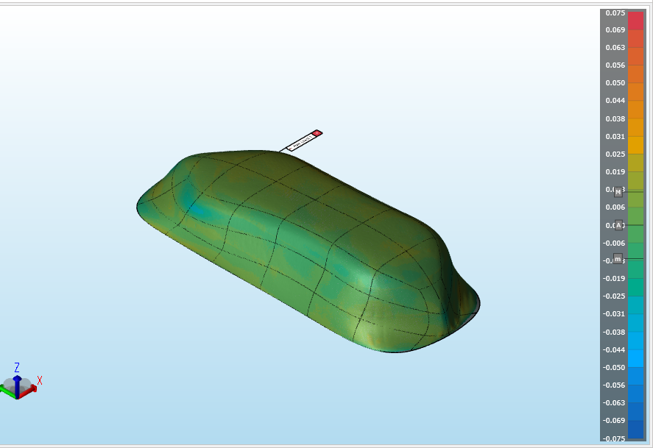
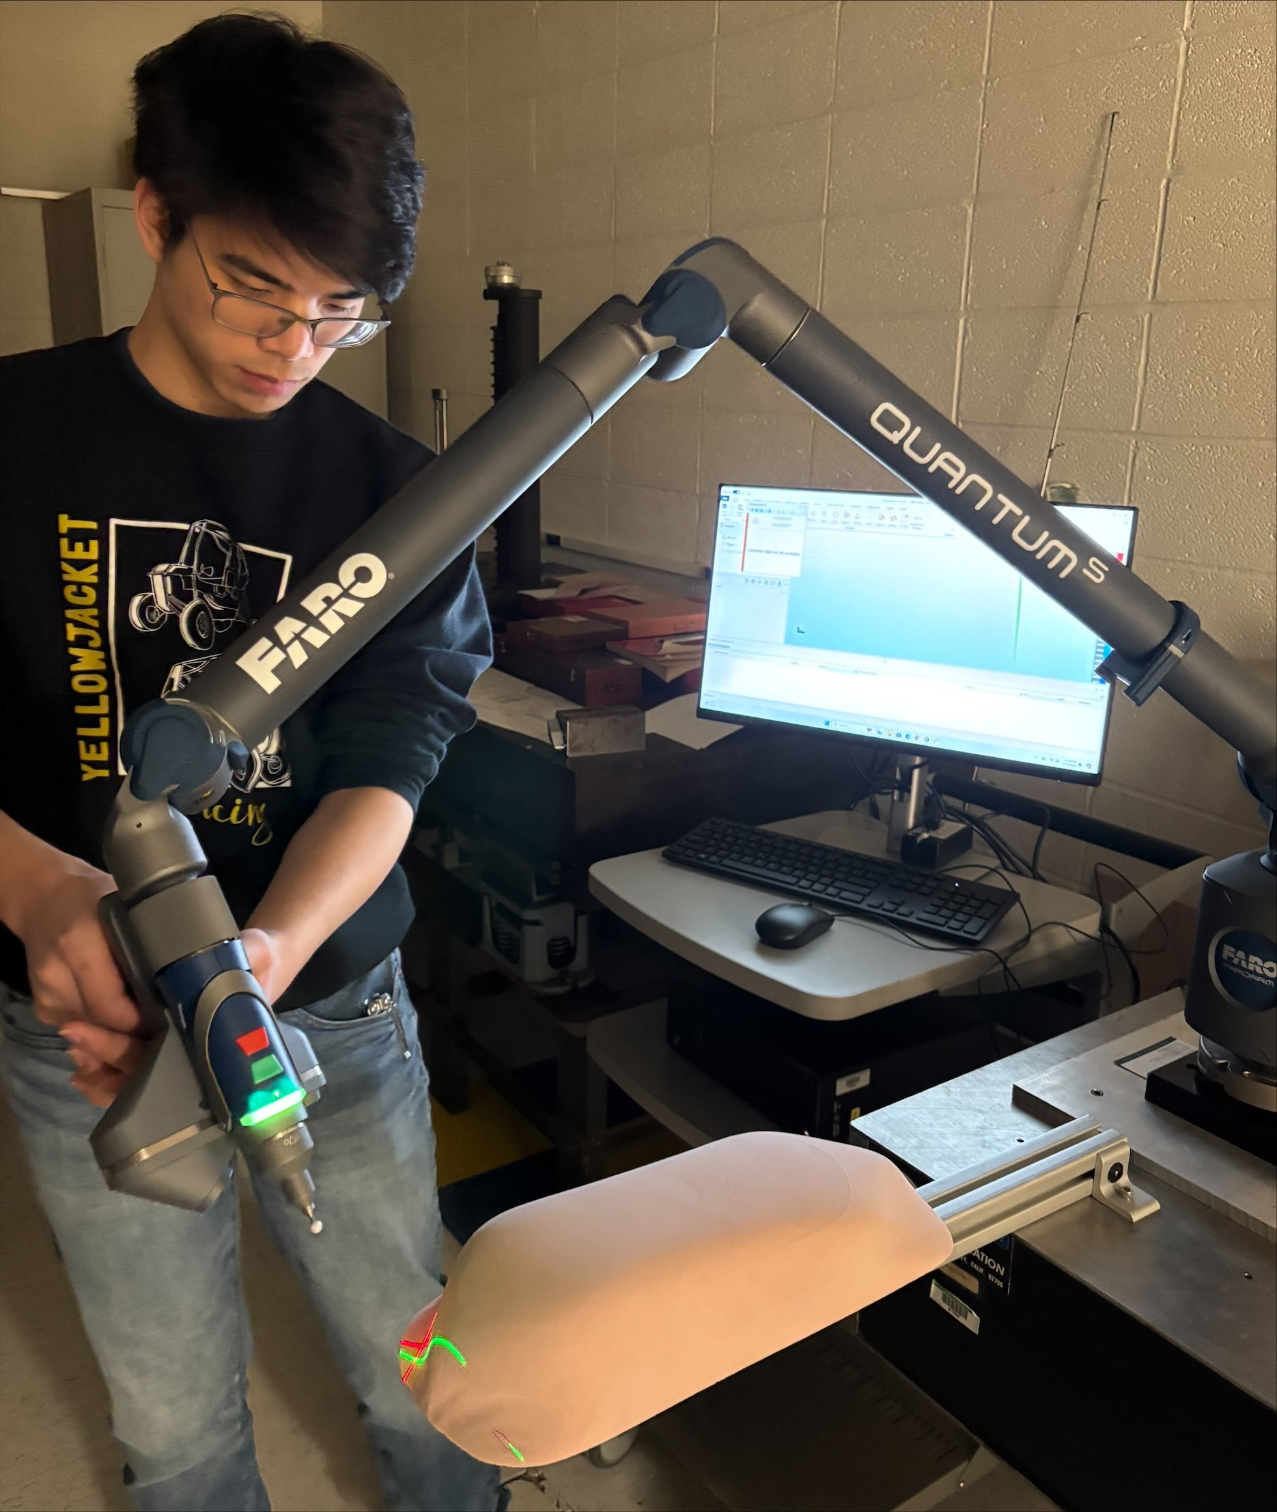
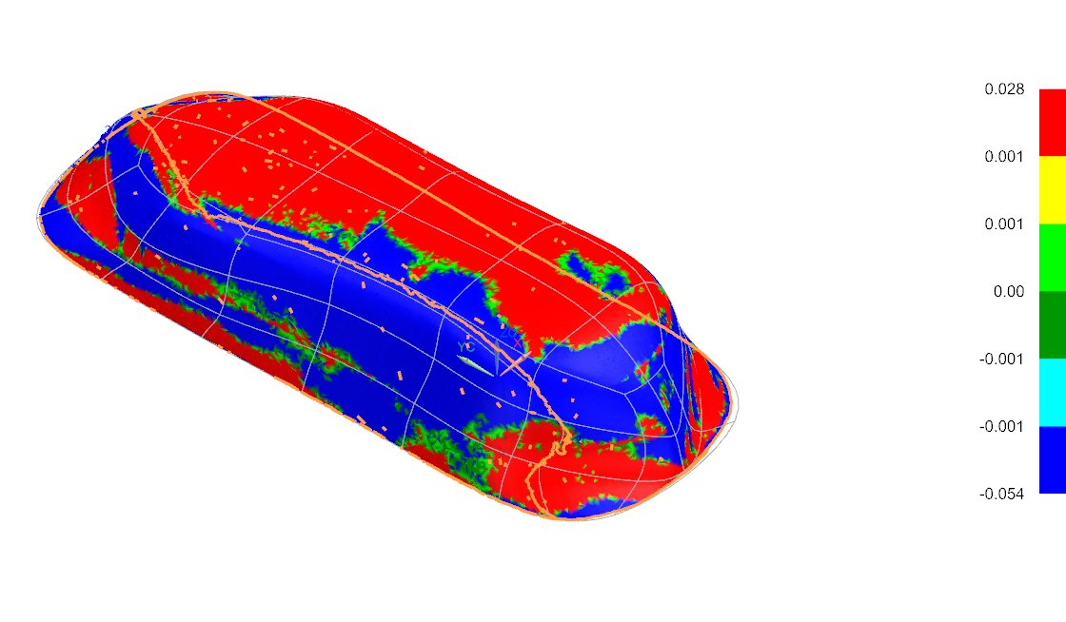
Project 1, Team ALD (Liao), Item 5
Geometry scanned in CAM2 software with deviation map
Team member scanning mold with FARO laser scanning tool
Colormap of geometry imported to NX, simplified
(Chordal Deviation 0.01”, Angle 0.5), compared to model

Slide 6
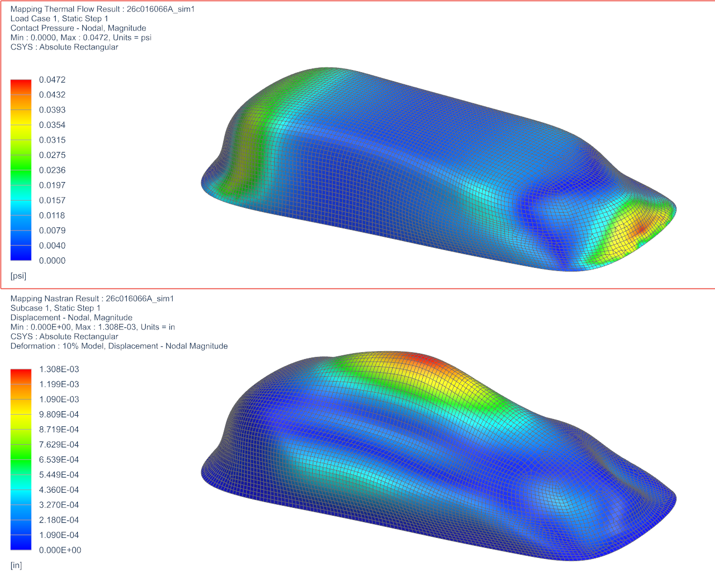
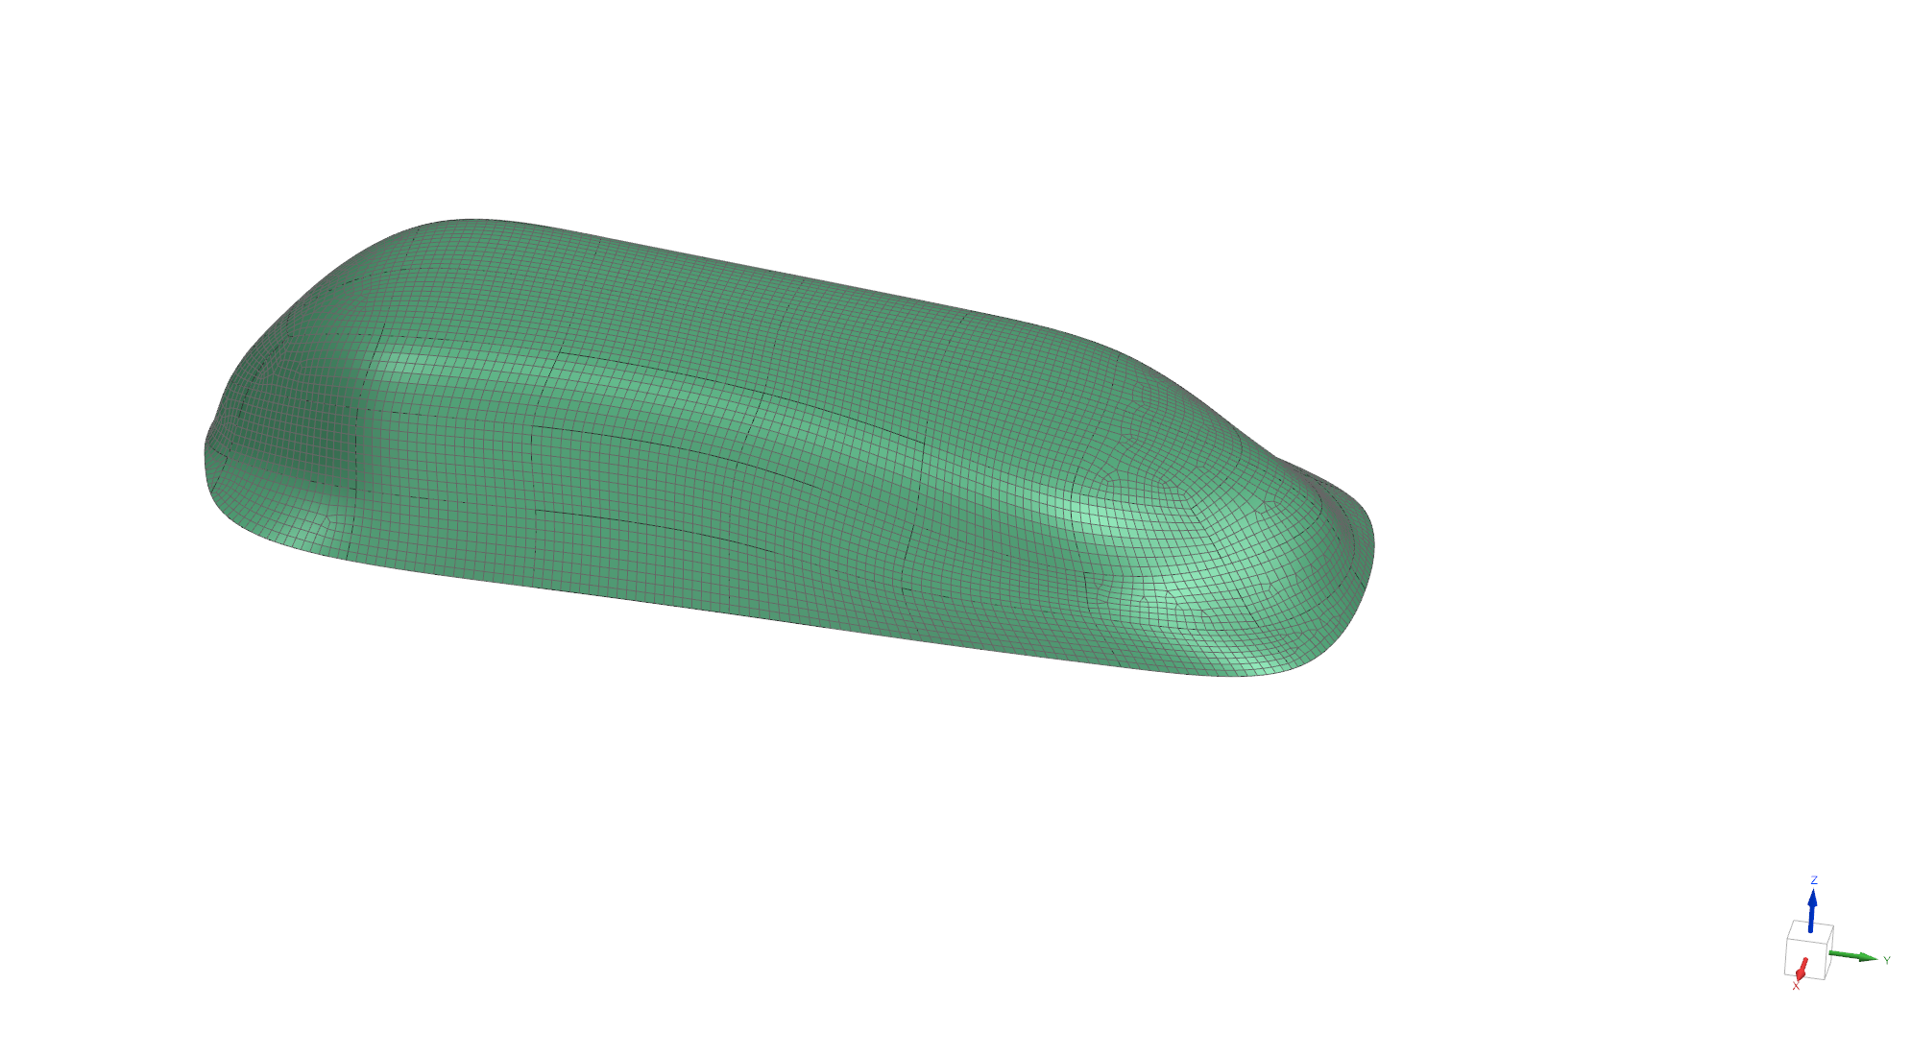
Project 1, Team ALD (Jason Cao), Item 6
Structural response for 0.03'' ABS from CFD Loading
Solution: Nastran 101 Linear Static
Transferred Pressure Load from CFD
Elements: CQUAD 4
Mesh size: 0.125''
Material: ABS (NX)
Thickness: 0.03''
Pressure load applied from Thermal Flow Analysis
The bottom is cut by 0.1 '' to make sure the geometry is clean
Displacement filed due to pressure
Fixed constraint on the bottom edge

Slide 7
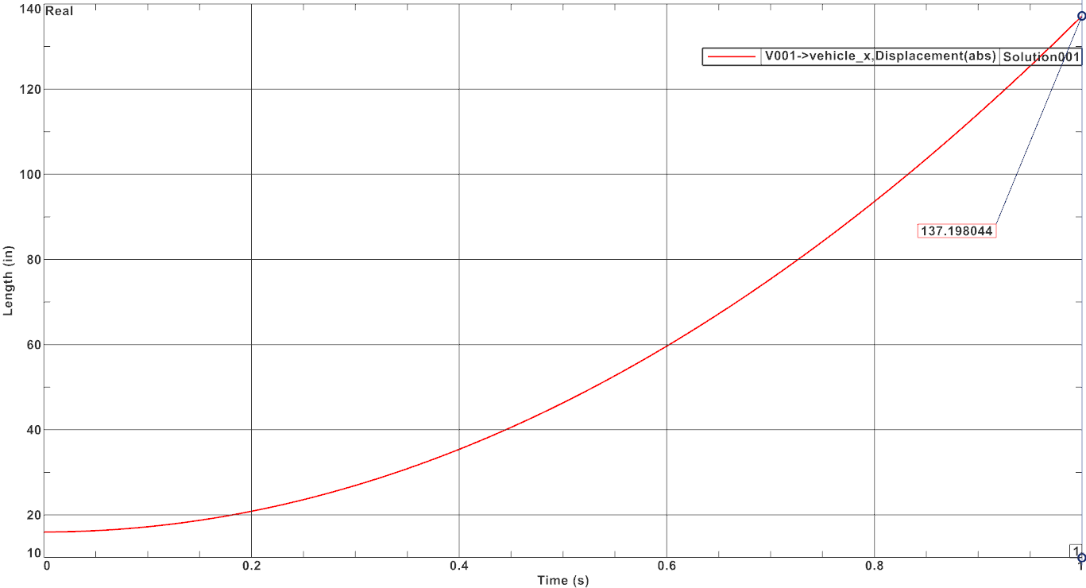
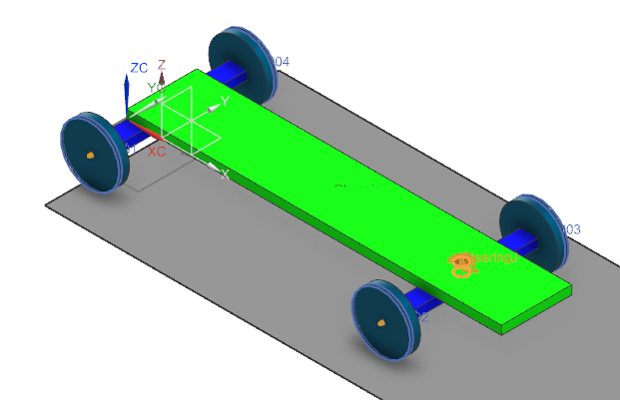
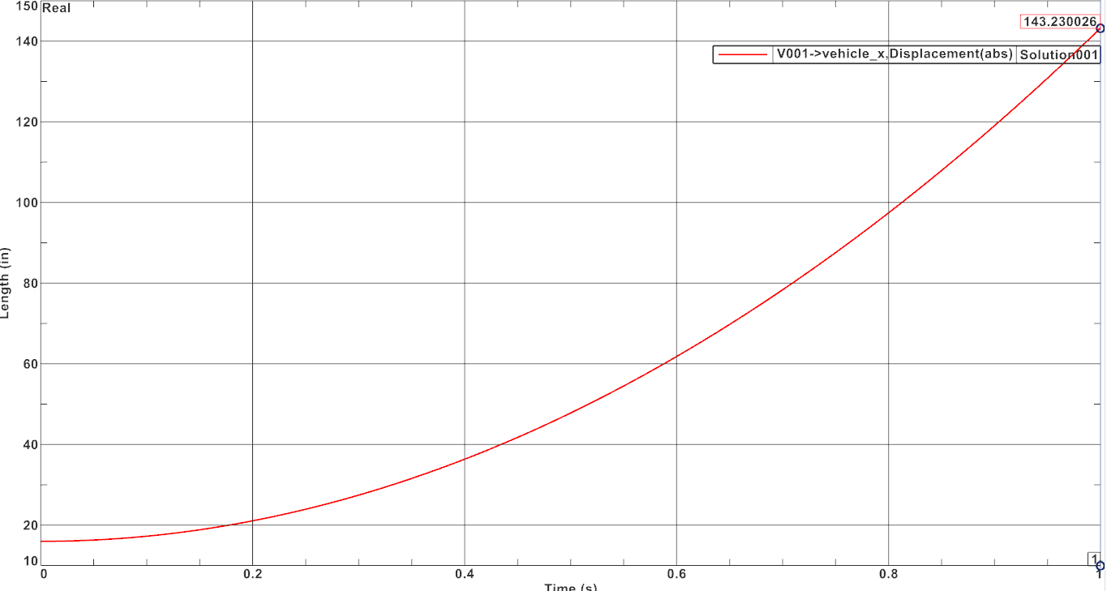
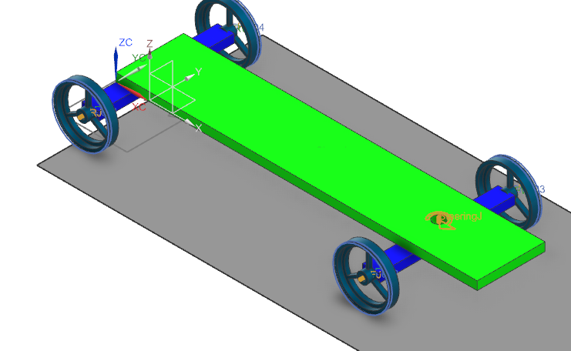

Project 1, Team ALD (Liao), Item 7
Gravity Car – Initial Wheel Design
All Components PVC
Gravity Car – Improved Wheel Design
All Components PVC
Improvement:$\frac{143−137}{137}∗100=4.3\%$

Slide 8
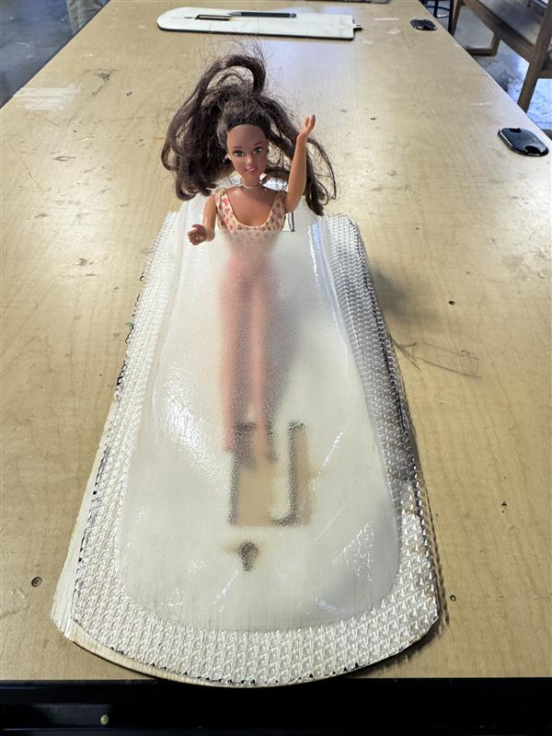
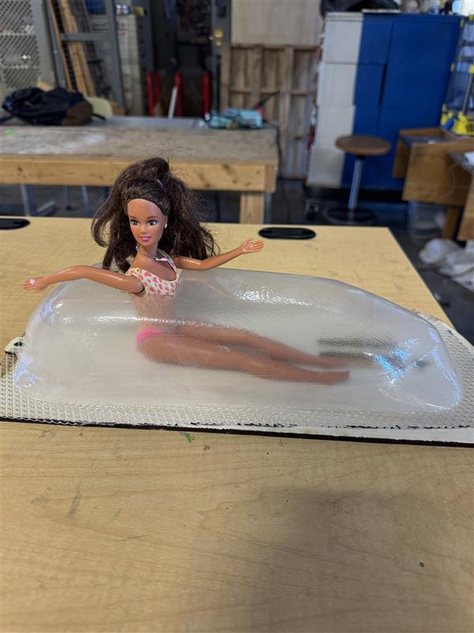
Project 1, Team ALD (Jason Cao), Item 8

Slide 9
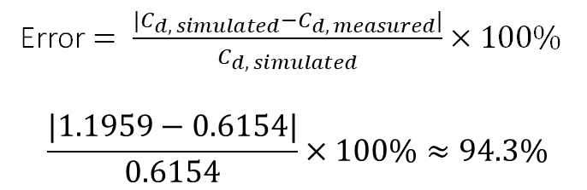
Project 1, Team ALD (Groeschel), Item 9
1. Original design of car shape.
4. Pressure plot in CFD simulation.
7. Gravity car with improved wheel design.
5. Colormap of geometry of scanned mold.
Error $= \frac{{|C}_{d, simulated}−C_{d, measured}|}{C_{d, simulated}}×100\%$
$$\frac{|1.1959−0.6154|}{0.6154}×100\%≈94.3\%$$
2. Tool path for creation of mold.
The measured drag coefficient is ~94.3% different from the simulated drag coefficient. This may be caused by the difference in real shape to the ideal part that is simulated, the conditions of the wind tunnel not being equal to that of the simulation (i.e. the wind speed being different), or some mechanical error in the wind tunnel.
3. Mold in wind tunnel.
6. Pressure load and displacement of moldable body

Slide 10
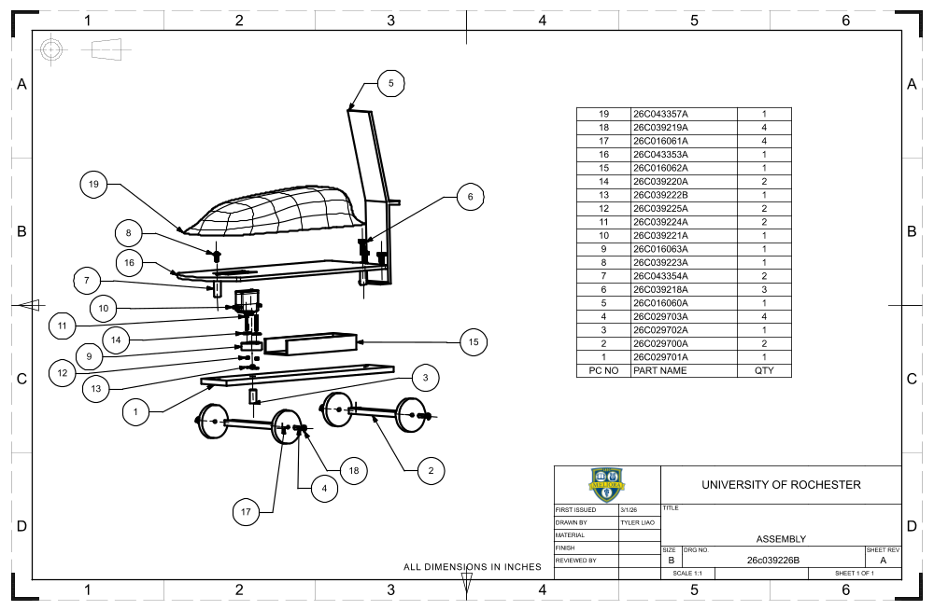
Project 1, Team ALD (Liao), Item 0
Tyler created the assembly and procured all the “bought” parts

Slide 11
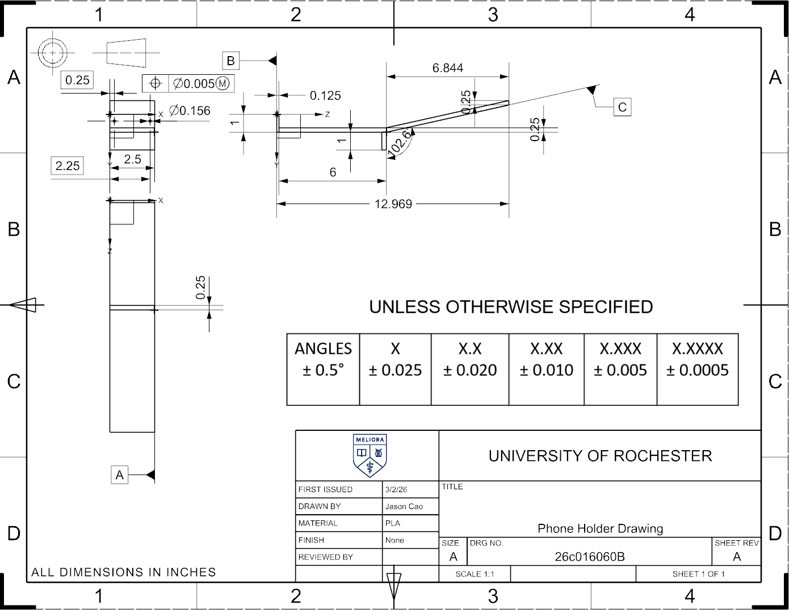
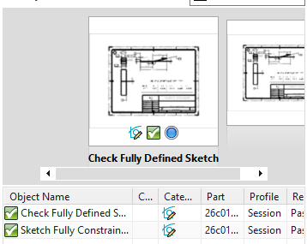
Project 1, Team ALD (Jason Cao), Item 0
26c016060A
#1 – Phone Holder
Part Info Version: 1.0
File Name: 26c016060A.prt
Description: Phone Holder
Version: 38
Last Save:02 Mar 26 14:38
Author:ccao10

Slide 12
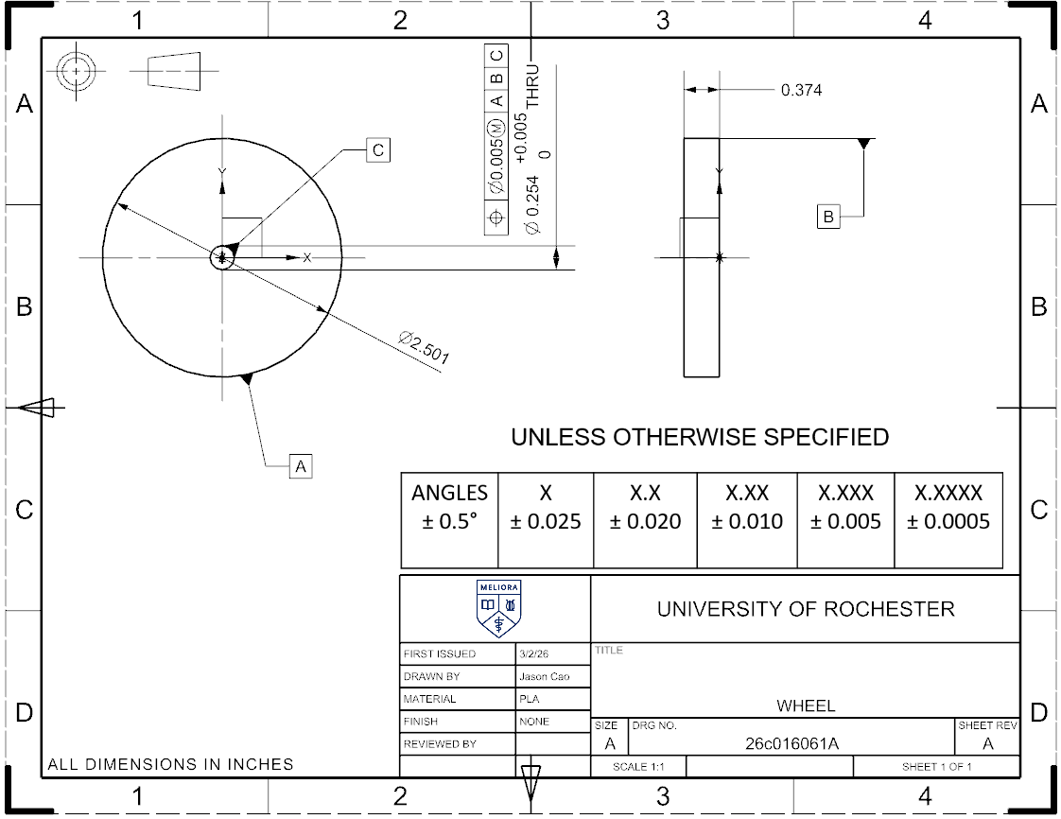
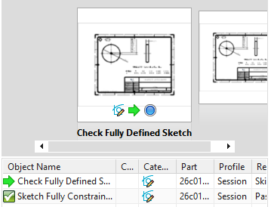
Project 1, Team ALD (Jason Cao), Item 0
26c016061A
#2 – Wheel
Part Info Version: 1.0
File Name: 26c016061A.prt
Description: Wheel
Version: 38
Last Save:02 Mar 26 15:59
Author:ccao10

Slide 13
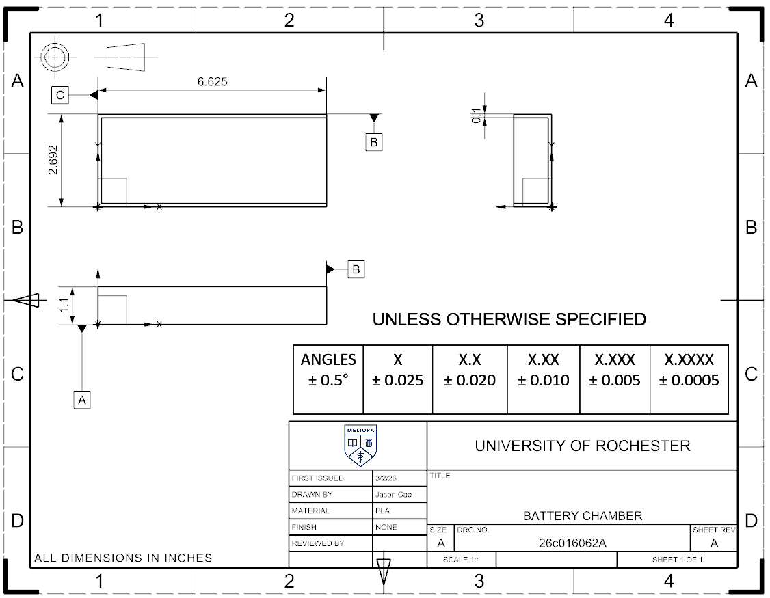
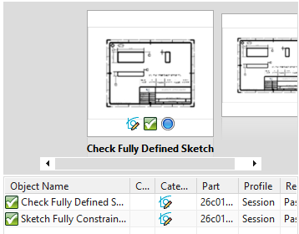
Project 1, Team ALD (Jason Cao), Item 0
26c016061A
#3 – Battery Chamber
Part Info Version: 1.0
File Name: 26c016062A.prt
Description: Battery Chamber
Version: 38
Last Save:02 Mar 26 16:15
Author:ccao10

Slide 14
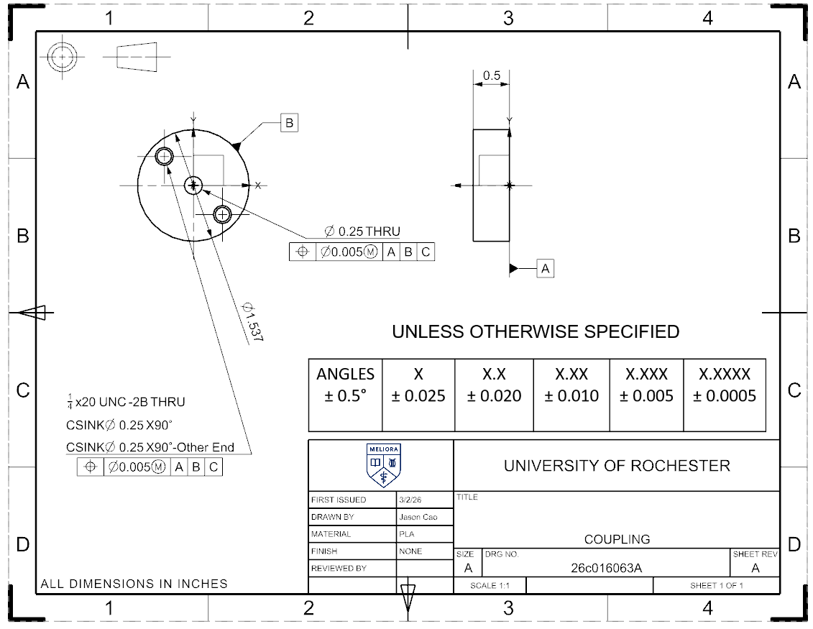
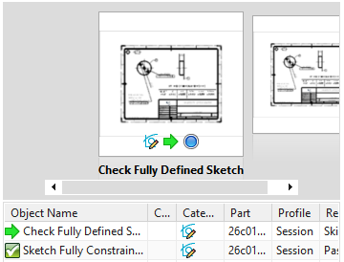
Project 1, Team ALD (Jason Cao), Item 0
26c016063A
#4 – Coupling
Part Info Version: 1.0
File Name: 26c016063A.prt
Description: Coupling
Version: 36
Last Save:02 Mar 26 16:15
Author:ccao10

Slide 15
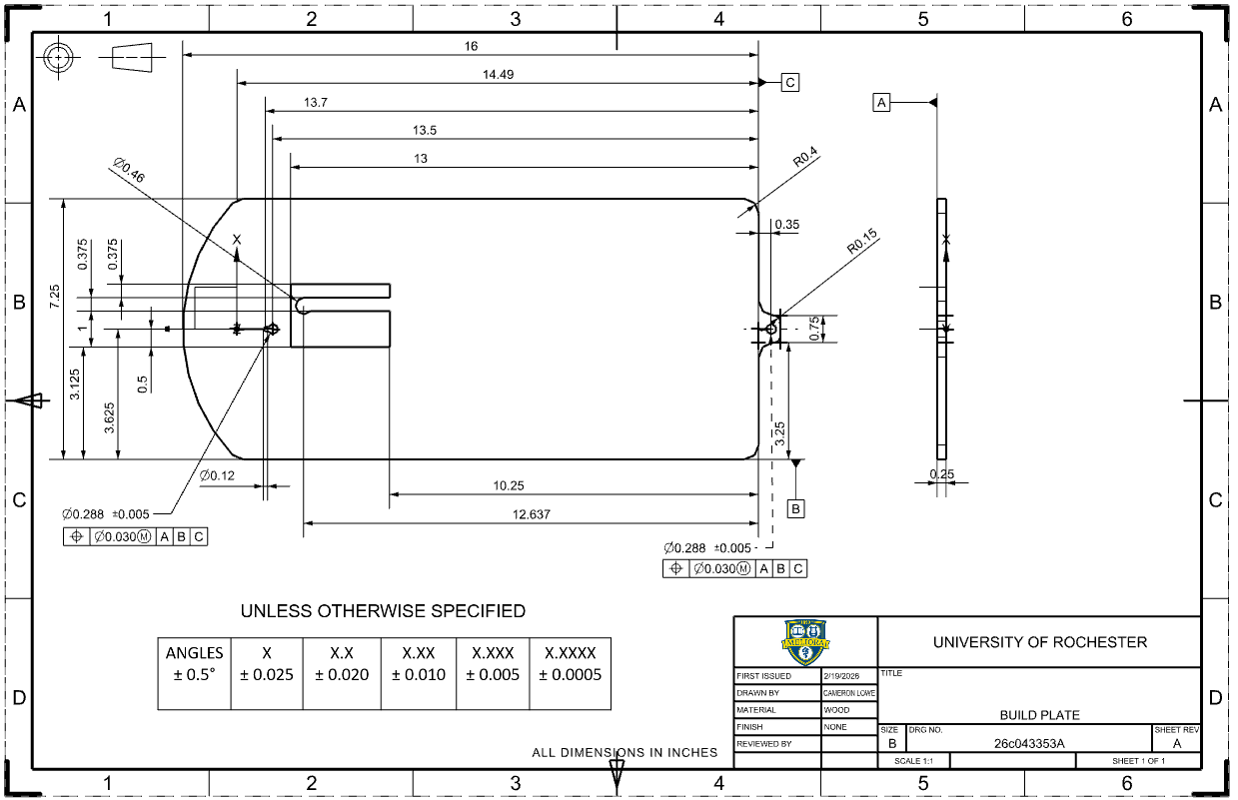
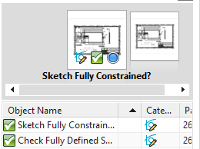
Project 1, Team ALD (Lowe), Item 0
26c043353A
#5 – Build Plate
Part Info Version: 1.0
File Name: 26c043353A.prt
Description: BUILD PLATE
Version: 39
Last Save:19 Feb 26 19:07
Author:clowe4

Slide 16
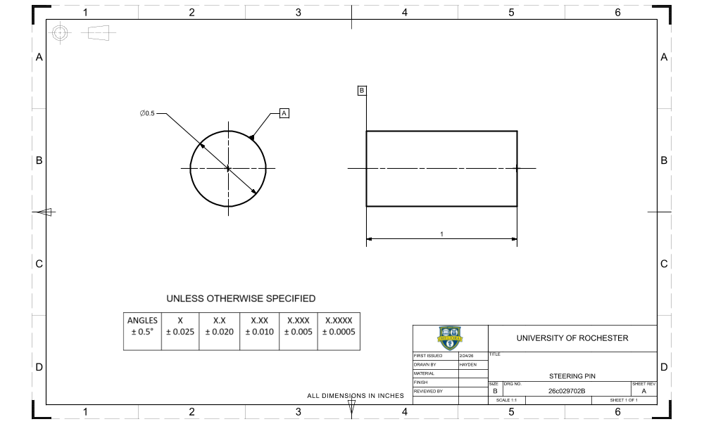
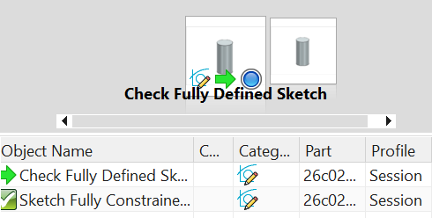
Project 1, Team ALD (Groeschel), Item 0
26c029702B
#6 – Steering Pin
Part Info Version: 1.0
File Name: 26c029702B.prt
Description: STEERING PIN
Version: 41
Last Save:24 Feb 26 17:39
Author:hgroe

Slide 17
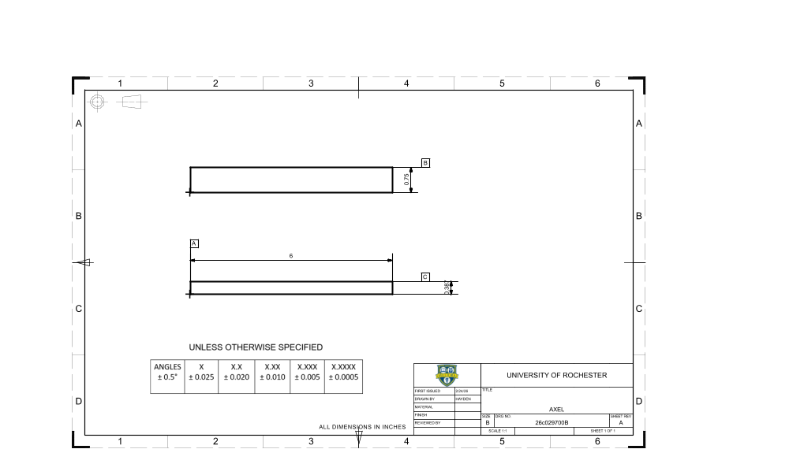
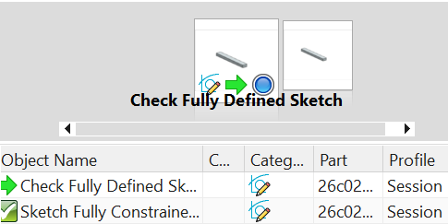
Project 1, Team ALD (Groeschel), Item 0
26c029700B
#7 - Axel
Part Info Version: 1.0
File Name: 26c029700B.prt
Description: AXEL
Version: 40
Last Save:24 Feb 26 17:28
Author:hgroe

Slide 18
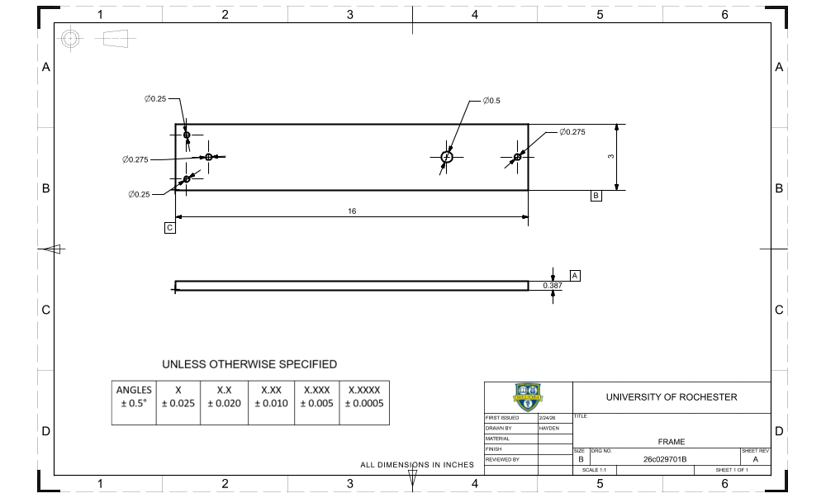
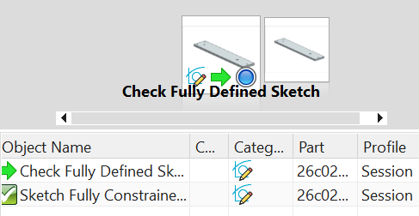
Project 1, Team ALD (Groeschel), Item 0
26c029701B
#8 - Frame
Part Info Version: 1.0
File Name: 26c029701B.prt
Description: FRAME
Version: 43
Last Save:24 Feb 26 17:31
Author:hgroe

Slide 19
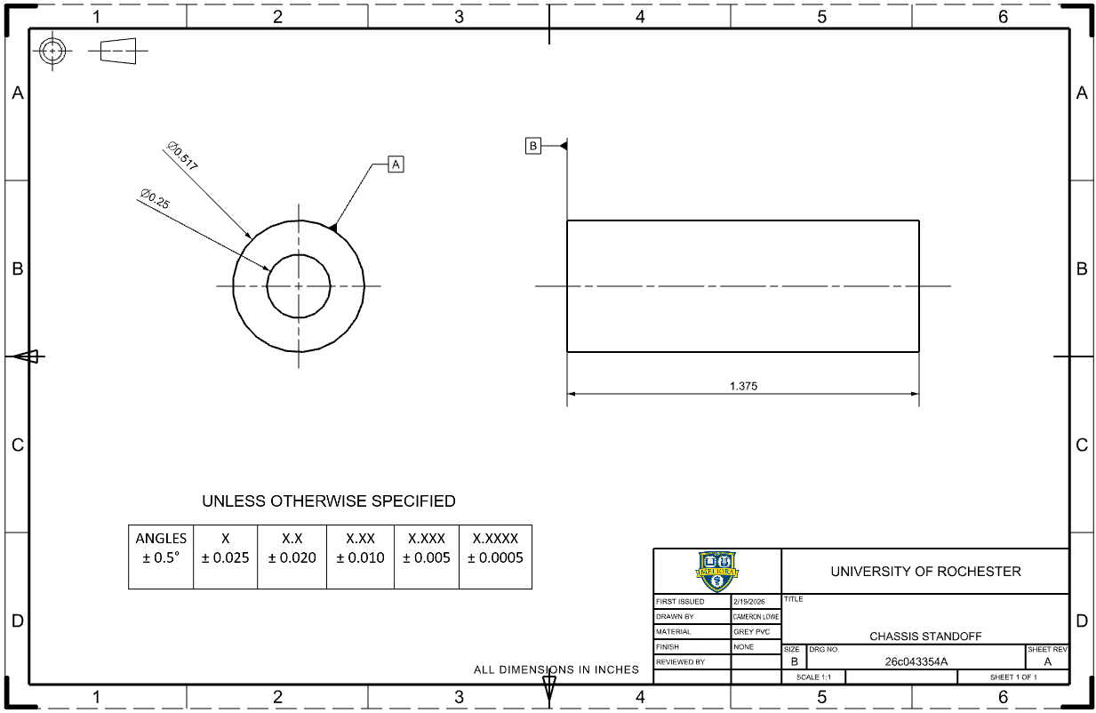
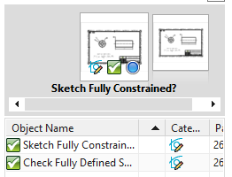
Project 1, Team ALD (Lowe), Item 0
26c043354A
#9 – Chassis Standoff
Part Info Version: 1.0
File Name: 26c043354A.prt Description: CHASSIS STANDOFF Version: 37
Last Save:19 Feb 26 19:20 Author:clowe4

Slide 20
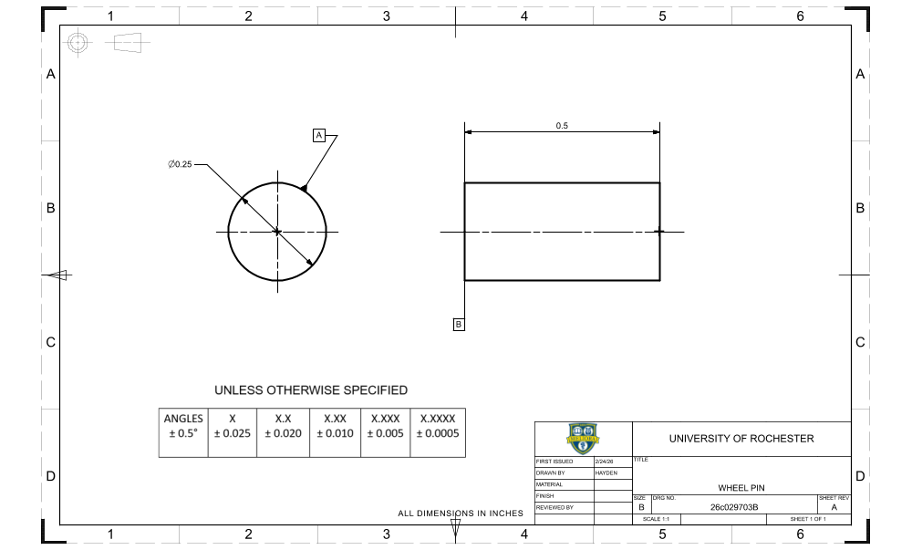
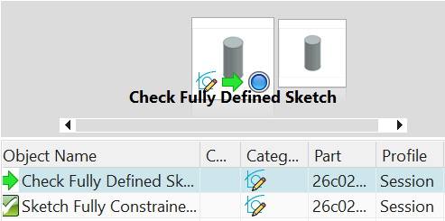
Project 1, Team ALD (Groeschel), Item 0
26c029703A
#10 – Wheel Pin
Part Info Version: 1.0
File Name: 26c029703B.prt
Description: WHEEL PIN
Version: 42
Last Save:24 Feb 26 17:40
Author:hgroe

